Slide 1
Toward General Linguistic Intelligence
Dani Yogatama
Notes:
Thank you for the introduction and thanks everyone for coming to my talk. I’m very happy to be back in Pittsburgh. Today, I’m going to talk about our research program in my group at DeepMind. I will also talk about a couple specific recent projects that we have done to make progress in this direction.

Slide 2
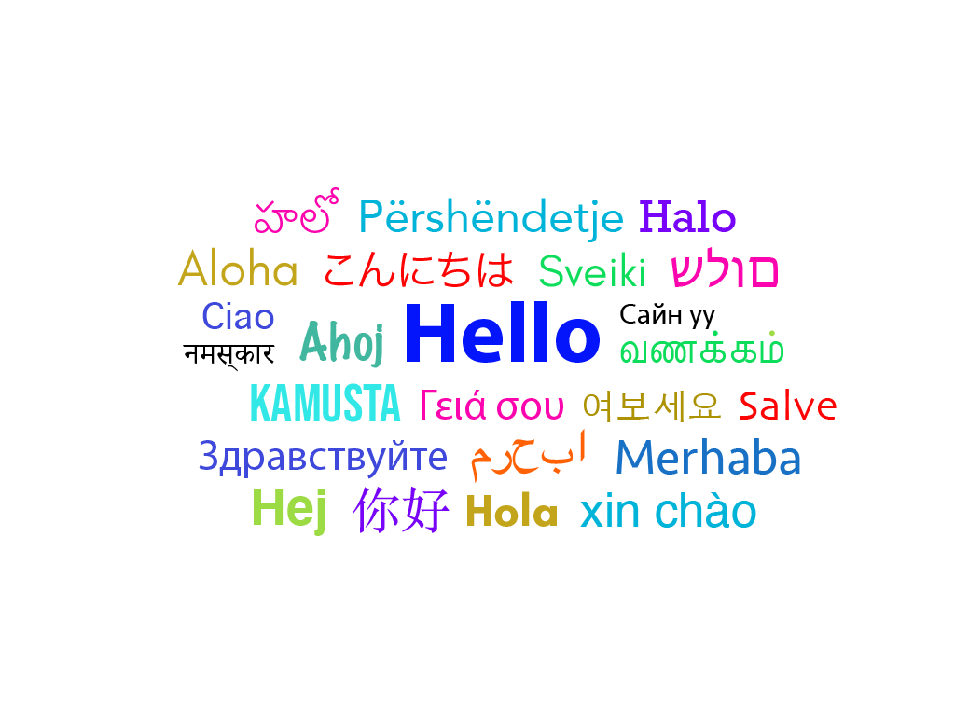
Language and Intelligence
A uniquely human ability that is a core component of our intelligence, independent of the surface forms it manifests in (Hockett, 1960).
Notes:
I want to start by discussing why I think language is a fascinating area to work on in AI. Language is something that we as humans developed a long time ago as a manifestation of our intelligence. Other intelligent beings such as animals communicate with one another through other mechanisms. There are thousands of languages in the world. What interesting about language is, the underlying mechanism on how we acquire and use it appears to be consistent regardless of the surface forms it takes.

Slide 3


Language and Intelligence
A primary medium through which we acquire new skills and knowledge (+visual perception).
Notes:
Talking about how we use language, there are two primary usages. The first one is for us to acquire new knowledge, for example, by reading a paper, listening to others. This is usually done in conjunction with other mediums such as visual perception.

Slide 4

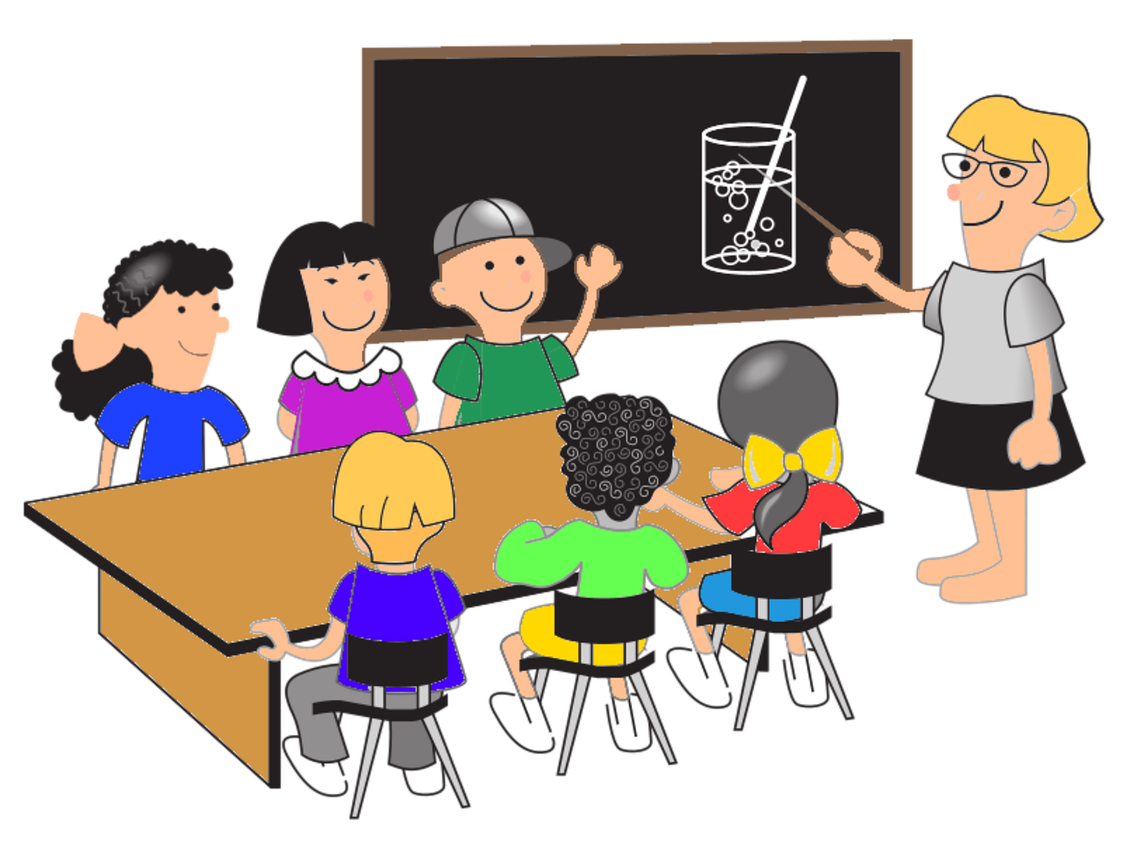
Language and Intelligence
The most effective form of communication to transmit information and knowledge to others.
(Language for communication; Wittgenstein, 1953; Austin, 1975)
Notes:
The second usage is for us to transmit our knowledge, for example by writing something or teaching others. Taken collectively, these two usages---acquire and transmit knowledge---allow us to progress as a civilization by preserving our knowledge across generations.

Slide 5

Language and Intelligence
A mechanism with which we formulate our thought process. (Language for thinking; Spelke, 2003)
Notes:
The second usage is for us to transmit our knowledge, for example by writing something or teaching others. Taken collectively, these two usages---acquire and transmit knowledge---allow us to progress as a civilization by preserving our knowledge across generations.

Slide 6
Language and Intelligence
Language is key to human intelligence and is important for artificial intelligence.
Notes:
Since language is such a core component of human intelligence, I believe that it is important for an AI system to exhibit linguistic intelligence as well. Many AI pioneers in the past, including Alan Turing and Marvin Minsky, also agree that language is central to AI.

Slide 7
General Linguistic Intelligence
The ability to acquire, store, and reuse knowledge (about a language’s lexicon, syntax, semantics, and pragmatic conventions) from textual data to adapt to new tasks quickly without forgetting old ones.
Notes:
In this talk, I will discuss our research toward general linguistic intelligence. GLI is a very broad term, but I will limit our scope by using the following definition: the ability to acquire, store, and reuse knowledge from text to adapt to new tasks quickly without forgetting old ones.
To be more concrete, we can imagine an agent that continually learn by reading everything on the web and is able to perform multiple tasks such as answering questions and summarization, in all languages. Importantly, it should be able to reason and make inferences about new things. For example, if it has read all arxiv papers, we could ask what method is possibly good to solve problem X. This is beyond the capability of existing question answering systems that work well on factual questions that do not require complex reasoning.

Slide 8
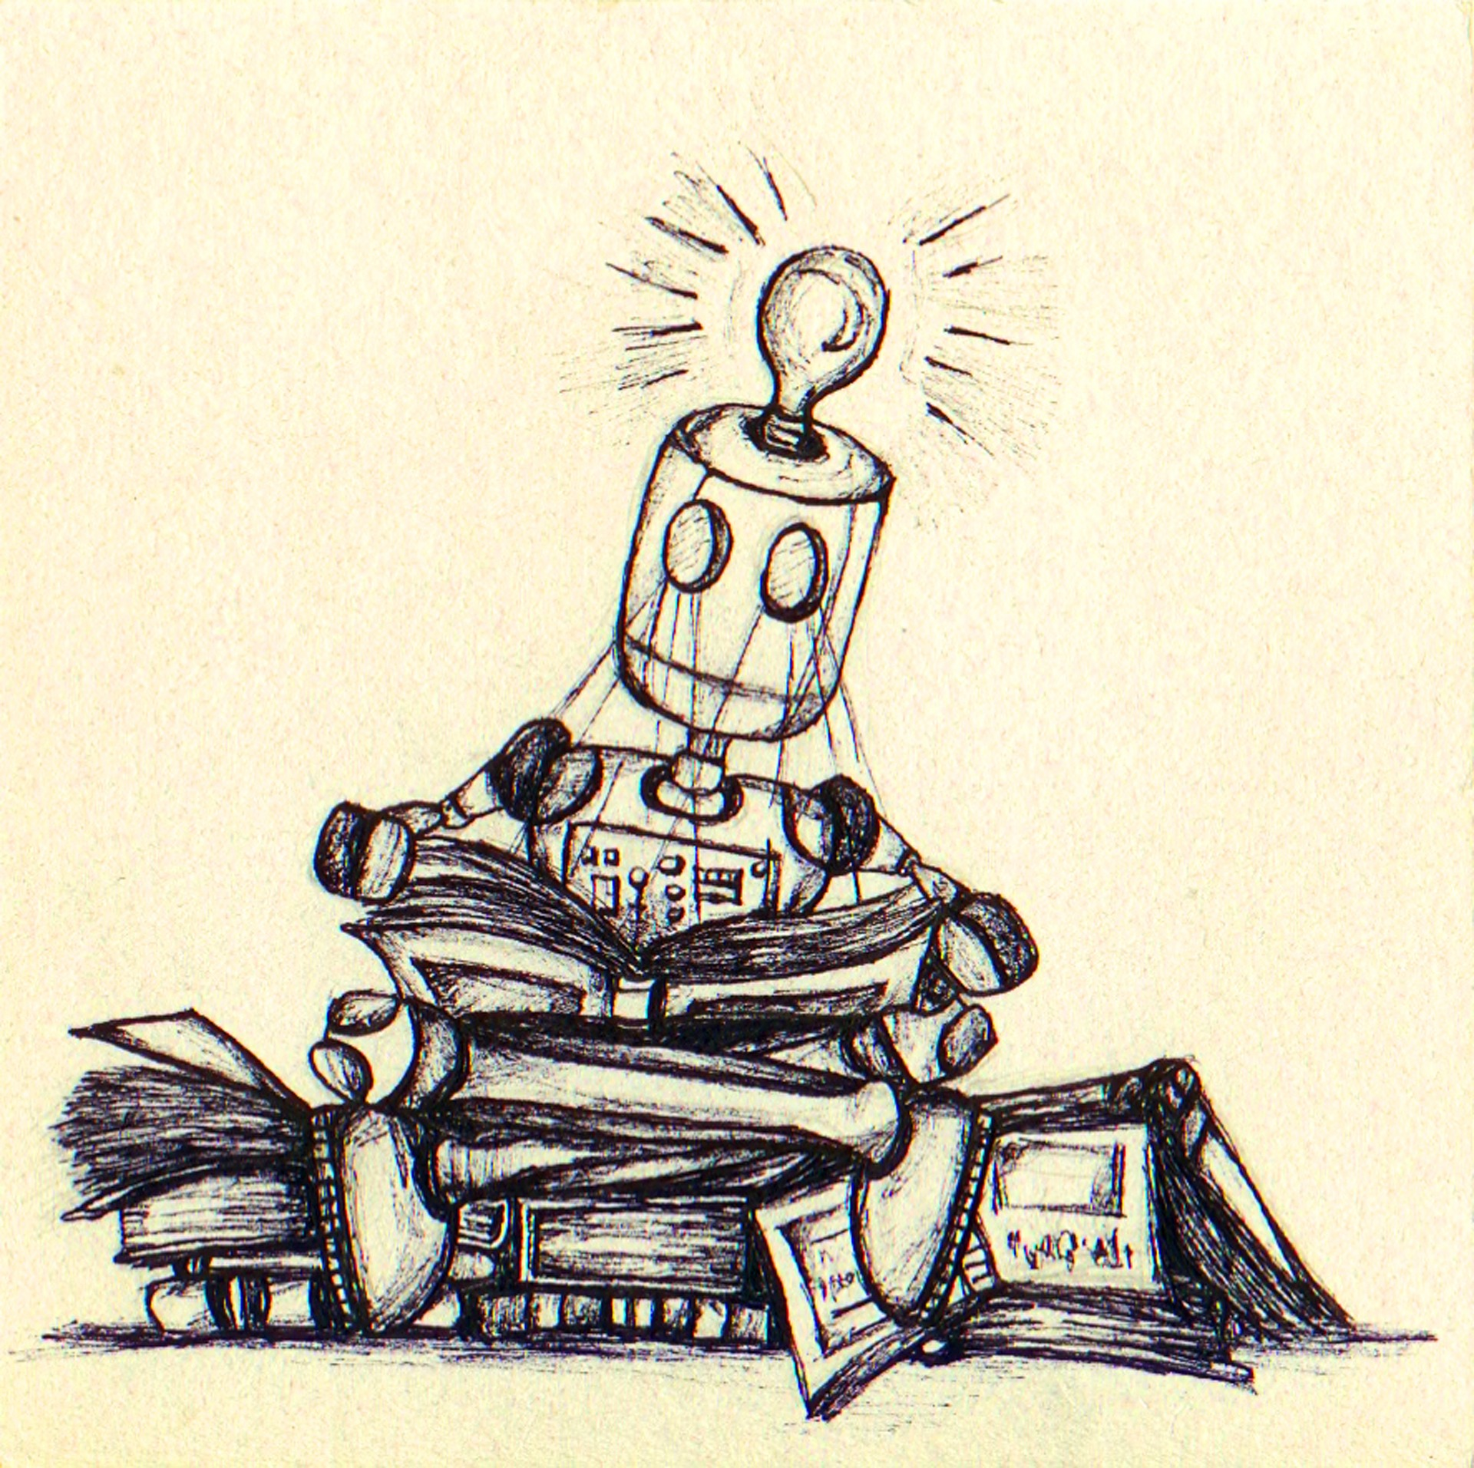
General Linguistic Intelligence
The ability to acquire, store, and reuse knowledge (about a language’s lexicon, syntax, semantics, and pragmatic conventions) from textual data to adapt to new tasks quickly without forgetting old ones.
Notes:
== remove ()
In this talk, I will discuss our research toward general linguistic intelligence. GLI is a very broad term, but I will limit our scope by using the following definition: the ability to acquire, store, and reuse knowledge from text to adapt to new tasks quickly without forgetting old ones.
To be more concrete, we can imagine an agent that continually learn by reading everything on the web and is able to perform multiple tasks such as answering questions and summarization, in all languages. Importantly, it should be able to reason and make inferences about new things. For example, if it has read all arxiv papers, we could ask what method is possibly good to solve problem X. This is beyond the capability of existing question answering systems that work well on factual questions that do not require complex reasoning.

Slide 9

General Linguistic Intelligence
The ability to acquire, store, and reuse knowledge (about a language’s lexicon, syntax, semantics, and pragmatic conventions) from textual data to adapt to new tasks quickly without forgetting old ones.
Notes:
In this talk, I will discuss our research toward general linguistic intelligence. GLI is a very broad term, but I will limit our scope by using the following definition: the ability to acquire, store, and reuse knowledge from text to adapt to new tasks quickly without forgetting old ones.
To be more concrete, we can imagine an agent that continually learn by reading everything on the web and is able to perform multiple tasks such as answering questions and summarization, in all languages. Importantly, it should be able to reason and make inferences about new things. For example, if it has read all arxiv papers, we could ask what method is possibly good to solve problem X. This is beyond the capability of existing question answering systems that work well on factual questions that do not require complex reasoning.

Slide 10

Challenges: Human Learning vs. Machine Learning
Human
``Large’’ datasets | Acquisition
Few examples | Task Training
Dataset agnostic | Linguistic knowledge
Generalizable to new tasks | Generalization
Notes:
What are the main challenges to achieve this goal? In order to get a better idea, let us first discuss how we learn as humans and how machines learn. I do not think that machines need to learn in exactly the same way as humans, but it would be good to take inspirations from the only systems that we know can generalize efficiently and do complex reasoning. In the context of language learning, humans are primed to acquire language. Some school of thoughts---Chomskyans---even suggest that it is innate. I am not going to get into this debate, but we are being exposed to many conversations with our family and friends in our early years. We receive some formal language education at school, but they are quite limited in quantity. After we understand language, we suddenly can do so many tasks with few examples (question answering, summarization). Bilingual speakers can translate naturally. I think this is something that is amazing.
(important issue you should address: humans are "primed" to acquire language (the Chomskyans put it even more strongly) -- it's not just about the training data, but also about the inductive bias. you don't want to get into that debate but it's probably worth signaling that you are, at least, aware of it!!)

Slide 11

Challenges: Human Learning vs. Machine Learning
Human |  | Machine
``Large’’ datasets | Acquisition | Large datasets (representation learning)
Few examples | Task Training | Large datasets (supervised fine tuning)
Dataset agnostic | Linguistic knowledge | Dataset specific
Generalizable to new tasks | Generalization | Forget previous tasks given a new task
Notes:
For machine learning, recent progress in self supervised learning has resulted in state-of-the-art models on many downstream tasks that require fewer training examples. With this approach, a model is first exposed to a large amount of unlabeled text and learns from it, often called representation learning. The pretrained model is then fine-tuned on a specific task of interest. However, each model still requires massive annotated training examples for the task of interest, sometimes in the order of tens of thousands to hundreds of thousands examples. The resulting model is also very problem specific. When it is trained on a new task, it forgets most things it has learned about other previous tasks. We are wasting so much compute by specializing our model for every new task, where many of the things the model learn should actually be generalizable across tasks. I will illustrate this point more clearly specifically for NLP models in the next slide.

Slide 12
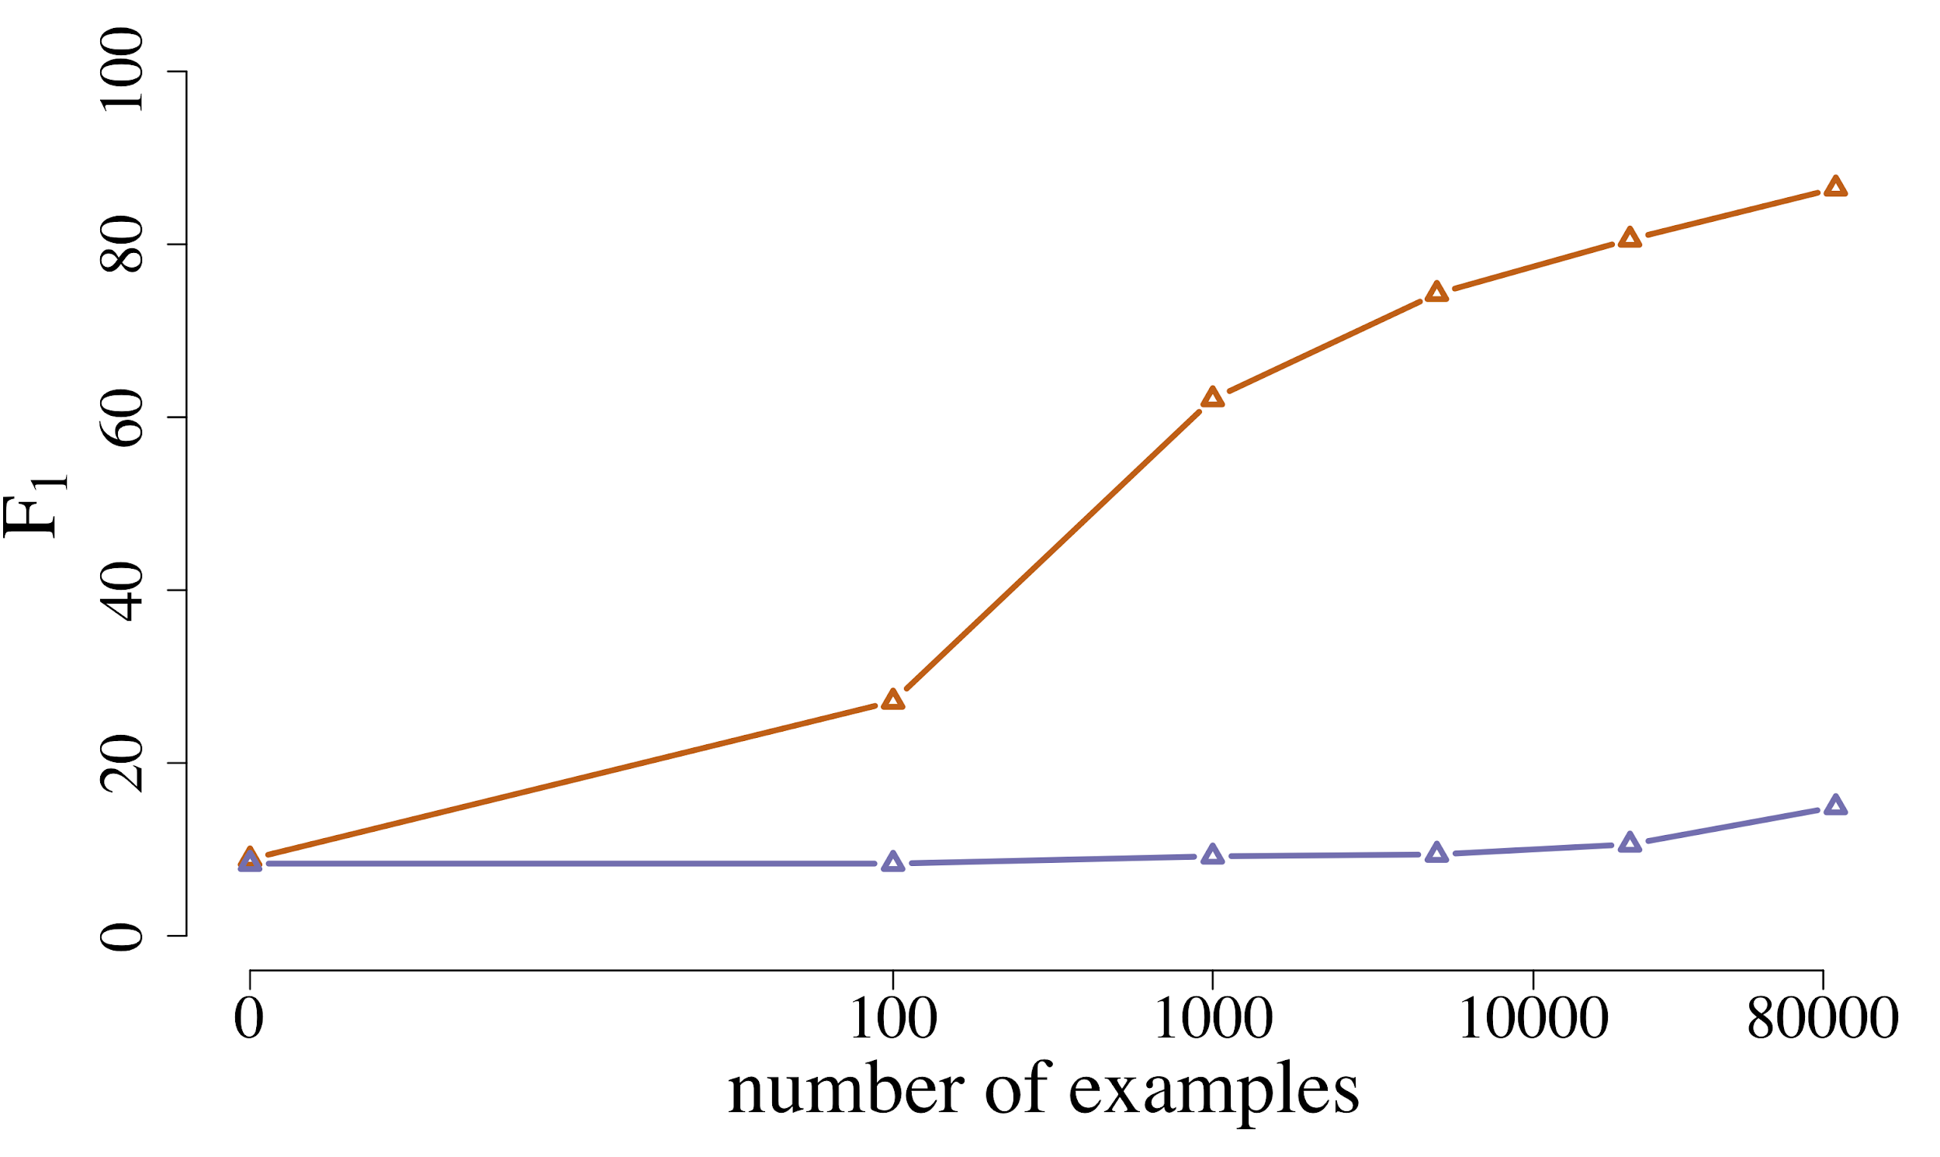
The State of Natural Language Processing
Current models still require many in-domain training examples.
With self-supervised learning
Without
Yogatama et al., arXiv 2019
Model: BERT, Devlin et al. 2019
QA dataset: SQuAD, Rajpurkar et al., 2016
Notes:
Here, we have two plots from a position paper that my colleagues and I wrote about a year ago. We have performance score on the y axis and the number of training examples on the x axis. We show that a model trained from scratch (pink line), without being exposed to a lot of unlabeled data beforehand, even after seeing > 80,000 examples, still cannot do question answering. However, if we use models that were pretrained on unlabeled data first---denoted by BERT---, they perform reasonably well, above 80%, after seeing 10,000 examples. While this clearly shows the benefit of self-supervised pretraining, 10,000 examples are still too many and are limiting for generalizing to many tasks and languages. We should be aiming for a few hundreds at most.

Slide 13
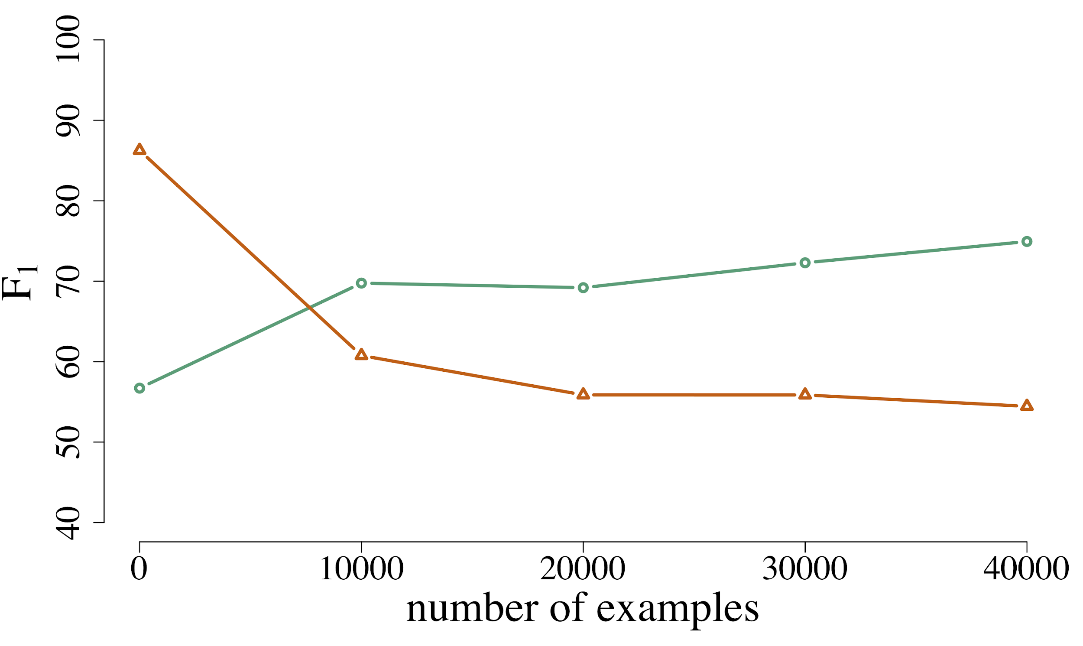
The State of Natural Language Processing
Current models still require many in-domain training examples.
They overfit to a specific dataset (task) and often forget.
With self-supervised learning
Trivia
Without
SQuAD
Yogatama et al., arXiv 2019
Model: BERT, Devlin et al. 2019
QA dataset: SQuAD, Rajpurkar et al., 2016
QA dataset 2: Trivia, Joshi et al., 2017
Notes:
On the right, we have another problem of catastrophic forgetting. Here, a model that has been trained to do well on a particular question answering dataset (SQuAD), is then trained on another question answering dataset (Trivia). The figure shows that as we give more training examples on the new dataset, progression on the x axis, the performance on the original dataset degrades. This clearly shows that the model forgets about the first dataset and overfits to the second dataset, even though they both are question answering datasets. The problem is much more server if the datasets are of different natures.

Slide 14

Research Areas
A language model that continually learns in an efficient way to perform multiple complex tasks in many languages.
Notes:
Our long-term goal is to build a universal language model that continually learns to perform multiple tasks in many languages. While we see bigger and bigger models every 6 months or so, I believe that there are some fundamental concepts that are missing from our current set of tools.

Slide 15
Research Areas
A language model that continually learns in an efficient way to perform multiple complex tasks in many languages.
Memory
Yogatama and Mann; AISTATS 2014
Yogatama et al., ICLR 2017
Yogatama et al., ICLR 2018
de Masson d’Autume et al.; NeurIPS 2019
Notes:
There are three interconnected research areas that my collaborators and I are working on. The first one is on memory-augmented neural networks, which I believe is key to allow a model to not forget.

Slide 16
Research Areas
A language model that continually learns in an efficient way to perform multiple complex tasks in many languages.
Memory
Representation Learning
Yogatama and Mann; AISTATS 2014
Yogatama et al., ICLR 2017
Yogatama et al., ICLR 2018
de Masson d’Autume et al.; NeurIPS 2019
Yogatama and Smith; ACL 2014
Yogatama and Smith; ICML 2015
Artetxe et al., arXiv 2019
Kong et al., ICLR 2020
Notes:
The second one is on incorporating architectural and structural biases to self-supervised methods. It is obvious that self-supervised pretraining reduces the number of training data needed, as we can see from the previous slide. I believe we need continued innovations to further improve its efficacy.

Slide 17
Research Areas
A language model that continually learns in an efficient way to perform multiple complex tasks in many languages.
Memory
Representation Learning
Generative Models
Yogatama and Mann; AISTATS 2014
Yogatama et al., ICLR 2017
Yogatama et al., ICLR 2018
de Masson d’Autume et al.; NeurIPS 2019
Yogatama and Smith; ACL 2014
Yogatama and Smith; ICML 2015
Artetxe et al., arXiv 2019
Kong et al., ICLR 2020
Yogatama et al., TACL 2014
Yogatama et al., arXiv 2017
Kong et al., ICLR 2018
Cao and Yogatama, arXiv 2020
Notes:
The last one is on generative models as an alternative to discriminative training. Generative models have been shown to be more sample efficient and can elegantly deal with many NLP tasks. In this talk, I will talk about our recent projects in the first two areas. I will defer discussions on our view on generative models to the part when I will talk about future directions.

Slide 18

Research Areas
A language model that continually learns in an efficient way to perform multiple complex tasks in many languages.
Memory
Representation Learning
Generative Models
Yogatama and Mann; AISTATS 2014
Yogatama et al., ICLR 2017
Yogatama et al., ICLR 2018
de Masson d’Autume et al.; NeurIPS 2019
Yogatama and Smith; ACL 2014
Yogatama and Smith; ICML 2015
Artetxe et al., arXiv 2019
Kong et al., ICLR 2020
Yogatama et al., TACL 2014
Yogatama et al., arXiv 2017
Kong et al., ICLR 2018
Cao and Yogatama, arXiv 2020
Reasoning, interactions with other modalities, robustness, fairness, and others.
Notes:
Also, I would like to add that there are other important abilities needed for general linguistic intelligence that I will not discuss in this talk, including the ability to do complex reasoning, interactions with other modalities, and robustness to adversaries, and others. We think a lot in these areas as well, so feel free to ask me questions about my view on these topics later.

Slide 19
This Talk
Episodic memory in lifelong language learning.
de Masson d’Autume et al., NeurIPS 2019
A framework for self-supervised language representation learning methods.
Kong et al., ICLR 2020
Notes:
So today, I will talk about two recent projects. The first one is on episodic memory in lifelong language learning. The second one is on a unified framework for self-supervised language representation learning methods.

Slide 20

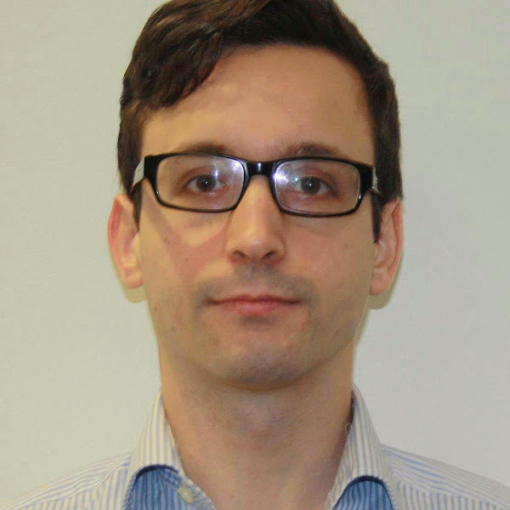
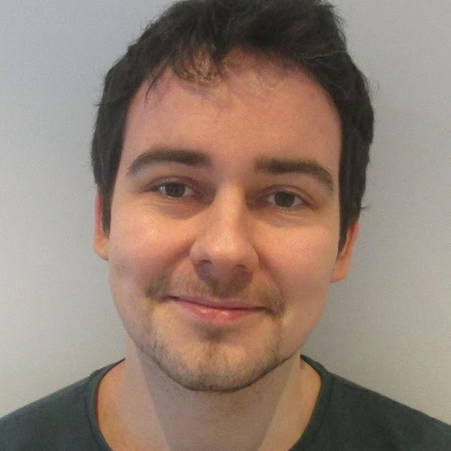
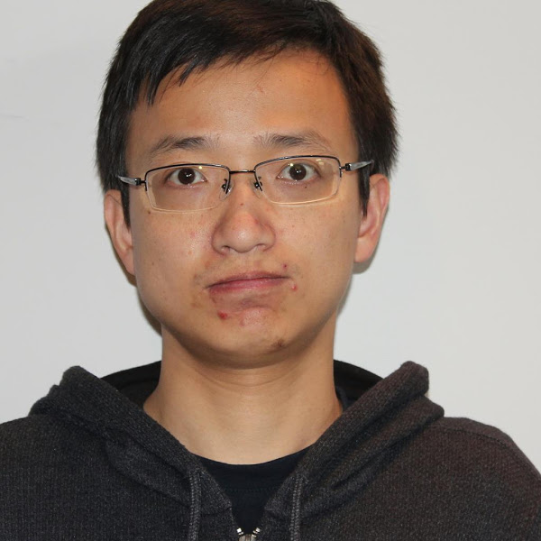
Episodic Memory in Lifelong Language Learning
de Masson d’Autume et al., NeurIPS 2019
Cyprien Sebastian Lingpeng Dani
Notes:
Okay, let us talk about episodic memory. This is joint work with many smart colleagues at DeepMind. Cyprien, in particular, was leading the execution of this project.

Slide 21
Background
A model should be able to reuse knowledge from related tasks to learn a new task faster.
Current models not only fail to do this, they catastrophically forget previously learned tasks (McCloseky and Cohen, 1989; Ratcliff, 1990).
Notes:
A little bit of background. As I have discussed earlier, a good model should be able to reuse knowledge acquired from previous tasks to learn a new task faster. However, existing models can only become an expert in one thing. The problem is not only that they fail to reuse knowledge from previous tasks to learn faster, they even forget how to do the previous tasks.

Slide 22




Background
A model should be able to reuse knowledge from related tasks to learn a new task faster.
Current models not only fail to do this, they catastrophically forget previously learned tasks (McCloseky and Cohen, 1989; Ratcliff, 1990).
Notes:
If we have an agent and three tasks, when the agent sees the first task, it will be able to do reasonably well given enough training examples on the first task.

Slide 23

Background
A model should be able to reuse knowledge from related tasks to learn a new task faster.
Current models not only fail to do this, they catastrophically forget previously learned tasks (McCloseky and Cohen, 1989; Ratcliff, 1990).
Notes:
As soon as the agent moves on to the second task and learns about it, it will be able to do well on this second task, but forgets how to do the first task.

Slide 24
Background
A model should be able to reuse knowledge from related tasks to learn a new task faster.
Current models not only fail to do this, they catastrophically forget previously learned tasks (McCloseky and Cohen, 1989; Ratcliff, 1990).
Notes:
Similar for the third task, as soon as it learns how to perform it well, it will not remember how to do the first two. This is an interesting phenomenon, often called catastrophic forgetting in the literature, that appears not just in a language model but in other domains as well. The only solution right now is to train the agent on all three tasks. This is not a long-term solution, since it is impractical. … There is something fundamentally wrong in the way we train our model that is manifested in this problem. We should learn the new task faster if we have seen so many previous other tasks.

Slide 25
Background
A model should be able to reuse knowledge from related tasks to learn a new task faster.
Current models not only fail to do this, they catastrophically forget previously learned tasks (McCloseky and Cohen, 1989; Ratcliff, 1990).
Hypothesis: episodic memory mitigates catastrophic forgetting in language learning.
Notes:
Our motivating hypothesis in this work is that augmenting a neural network language model with an episodic memory module mitigates this problem.

Slide 26
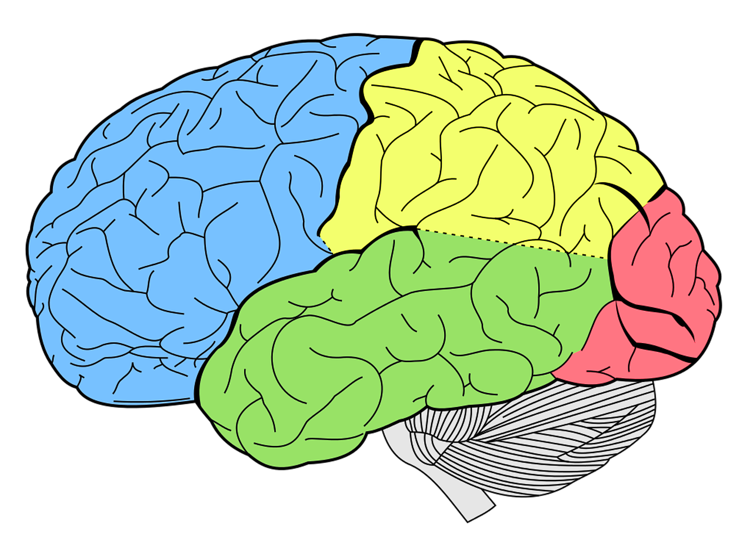
On Memory-Augmented Neural Networks
Episodic memory is a type of long-term memory of events and experiences. It is often associated with a module that stores training examples in neural networks..
Notes:
Before I talk about the model, I want to say a few things about memory-augmented neural networks. Memory in machine learning is an overloaded term that has many different interpretations. In this work, we consider episodic memory, which is a type of long-term memory of events and experiences. In humans, it encodes individual experiences of the world. In a neural network model, it is typically associated with a memory module that stores previously seen (training) examples.

Slide 27
On Memory-Augmented Neural Networks
Episodic memory is a type of long-term memory of events and experiences. It is often associated with a module that stores training examples in neural networks..
Contrast this with short-term working memory in LSTMs (Hochreiter and Schmidhuber, 1997) and DNCs (Graves et al., 2016) that e.g., remembers context.
See Yogatama et al., ICLR 2018 for comparisons of working memory models for language models.
Notes:
There are other types of memory in humans that are relevant for language processing. An important one is working memory, often called short-term memory as well. In machine learning, working memory would be the kind of memory modules we see in models such as LSTMs, stack augmented NNs, or differentiable neural computers. Their primary job is to model long sequences, for example, remembering things in a conversation thread or a long article. We also work in this area but I will not talk about it today. See our ICLR paper from a couple years ago for an overview of this memory system in the context of language models.

Slide 28
Problem Setup
TriviaQA: Joshi et al., 2017
Tanker leaks 6,000 tons of oil after running aground
The Independent, Friday 16 February 1996
A massive anti-pollution operation was underway last night after a 147,000-ton super tanker ran aground off Milford Haven, West Wales. [...]
Training
Which super-tanker ran aground near Milford Haven in 1996?
Notes:
So, to formalize the setup a bit more, consider an agent that has to learn three tasks, A, B, and C. After learning about task A, it will be evaluated on test examples associated with that task.

Slide 29
Problem Setup
SQuAD: Rajpurkar et al., 2016
Computational Complexity Theory. Computational complexity theory is a branch of the theory of computation in theoretical computer science that focuses on classifying computational problems according to their inherent difficulty [...]
Training
What branch of theoretical computer science deals with broadly classifying computational problems by difficulty and class of relationship?
Notes:
After that, the agent sees task B learns from examples in this task, and will be evaluated on both tasks A and B. Note that we do not evaluate on test examples from tasks which the agent has not learned about and the agent is not retrained on examples from task A after seeing task B.

Slide 30
Problem Setup
QuAC: Choi et al., 2018
Augusto Pinochet --- Intellectual life ...
Pinochet was publicly known as a man with a lack of culture. This image was reinforced by the fact [...]
Was he known for being intelligent? No, Pinochet was publicly known as a man with a lack of culture.
Training
Why did people feel that way?

Slide 31
Problem Setup
Training
Test
Notes:
This is a standard continual or lifelong learning setup that many people consider in the past. I would also like to take this opportunity to mention a lifelong learning project at CMU, NELL, that has a similar motivation to construct a knowledge base from text. Our project, on the other hand, is designed for a lifelong question answering model.

Slide 32
Problem Setup
Training
Never-Ending Language Learning
Mitchell et al., 2015
Test
Notes:
This is a standard continual or lifelong learning setup that many people consider in the past. I would also like to take this opportunity to mention a lifelong learning project at CMU, NELL, that has a similar motivation to construct a knowledge base from text. Our project, on the other hand, is designed for a lifelong question answering model.

Slide 33
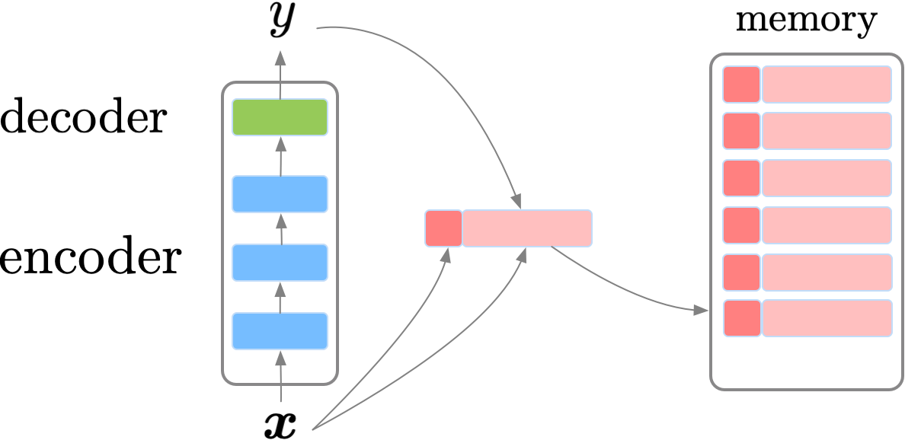
Question Answering Model
Notes:
Ok, so let us talk about our model now. Recall that our goal is to do question answering. This is an illustration of our model, and I will walk us through each component in the next few slides.

Slide 34
Question Answering Model
Input: a concatenation of context (e.g., a Wikipedia article) and question.
Notes:
First, we have an input x. Our input is a concatenation of context, for example a Wikipedia article, and a question.

Slide 35
Question Answering Model
Output: an answer, predicted as start and end indices of the answer in the context.
Notes:
Our goal is to output an answer for the question, which is assumed to exist in the context. The way our model will output the prediction is by predict the start and end indices of the answer in the context. This is usually called a span decoder and is a part of many state-of-the-art question answering systems.

Slide 36
Question Answering Model
Output: an answer, predicted as start and end indices of the answer in the context.
Computational complexity theory is a branch of the theory of computation in theoretical computer science that focuses on classifying computational problems according to their inherent difficulty [...]
What branch of theoretical computer science deals with broadly classifying computational problems by difficulty and class of relationship?
Notes:
Our goal is to output an answer for the question, which is assumed to exist in the context. The way our model will output the prediction is by predict the start and end indices of the answer in the context. This is usually called a span decoder and is a part of many state-of-the-art question answering systems.

Slide 37
Question Answering Model
Encoder: a large neural network, e.g., ELMo (Peters et al., 2018), BERT (Devlin et al., 2019), XLNet (Yang et al., 2019).
Notes:
Next, we have an encoder which takes our input and transforms it into some representations. Any large neural network can be used here.

Slide 38
Question Answering Model
Decoder: a linear function that predicts start and end indices of the answer in the context.
Notes:
We then have a decoder, which is just a linear function that takes as input representations learned by the encoder and predicts start and end indices, which is our output y.

Slide 39
Question Answering Model
Memory entry: a key, value pair
Notes:
That is the parametric part of our model. I will now describe our memory module. Each memory entry is a key, value pair. In the figure, the dark red box is the key, and the pink rectangle is the value.

Slide 40
Question Answering Model
Key: fixed embedding of a question from a pretrained encoder.
Notes:
== say key is for retrieval
Our key is a fixed embedding of the question part of x, encoded using some pretrained encoder.

Slide 41
Question Answering Model
Value: context, question, and answer in textual forms (strings).
Notes:
For the value, we just store context, question, and answer in textual forms or string.

Slide 42
Question Answering Model
Memory: stores memory entries
Notes:
So basically, we are storing training examples in our memory slots, where the key is an encoded representation of the question associated with an example.
Okay, is there any question about the model?

Slide 43
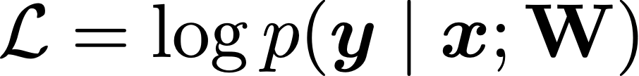
Training
Task A
Notes:
I will now describe how we use the memory during training. Training is done in a standard machine learning setup where given labeled examples x,y, we update parameters of our models using gradient descent to increase the probability of predicting this example.
At training time, we perform what we call sparse experience replay. It essentially samples a few random examples from the memory and retrain on those examples. Now, if we do not do experience replay sparsely, this defeats the entire purpose of our problem setup since it is equivalent to seeing all training examples all the time. However, we only do it very rarely, at a rate of 1% (meaning we only sample one example from the memory for every 100 new examples). This process is related to memory consolidation in human learning.

Slide 44
Training
Sparse experience replay: retrain on randomly sampled examples from the memory at a 1% rate.
Task A
Notes:
I will now describe how we use the memory during training. Training is done in a standard machine learning setup where given labeled examples x,y, we update parameters of our models using gradient descent to increase the probability of predicting this example.
At training time, we perform what we call sparse experience replay. It essentially samples a few random examples from the memory and retrain on those examples. Now, if we do not do experience replay sparsely, this defeats the entire purpose of our problem setup since it is equivalent to seeing all training examples all the time. However, we only do it very rarely, at a rate of 1% (meaning we only sample one example from the memory for every 100 new examples). This process is related to memory consolidation in human learning.

Slide 45
Training
Sparse experience replay: retrain on randomly sampled examples from the memory at a 1% rate.
Task A
Notes:
I will now describe how we use the memory during training. Training is done in a standard machine learning setup where given labeled examples x,y, we update parameters of our models using gradient descent to increase the probability of predicting this example.
At training time, we perform what we call sparse experience replay. It essentially samples a few random examples from the memory and retrain on those examples. Now, if we do not do experience replay sparsely, this defeats the entire purpose of our problem setup since it is equivalent to seeing all training examples all the time. However, we only do it very rarely, at a rate of 1% (meaning we only sample one example from the memory for every 100 new examples). This process is related to memory consolidation in human learning.

Slide 46
Training
Sparse experience replay: retrain on randomly sampled examples from the memory at a 1% rate.
Task A
Notes:
I will now describe how we use the memory during training. Training is done in a standard machine learning setup where given labeled examples x,y, we update parameters of our models using gradient descent to increase the probability of predicting this example.
At training time, we perform what we call sparse experience replay. It essentially samples a few random examples from the memory and retrain on those examples. Now, if we do not do experience replay sparsely, this defeats the entire purpose of our problem setup since it is equivalent to seeing all training examples all the time. However, we only do it very rarely, at a rate of 1% (meaning we only sample one example from the memory for every 100 new examples). This process is related to memory consolidation in human learning.

Slide 47
Training
Sparse experience replay: retrain on randomly sampled examples from the memory at a 1% rate.
Task A
Task A
Notes:
I will now describe how we use the memory during training. Training is done in a standard machine learning setup where given labeled examples x,y, we update parameters of our models using gradient descent to increase the probability of predicting this example.
At training time, we perform what we call sparse experience replay. It essentially samples a few random examples from the memory and retrain on those examples. Now, if we do not do experience replay sparsely, this defeats the entire purpose of our problem setup since it is equivalent to seeing all training examples all the time. However, we only do it very rarely, at a rate of 1% (meaning we only sample one example from the memory for every 100 new examples). This process is related to memory consolidation in human learning.

Slide 48
Training
Sparse experience replay: retrain on randomly sampled examples from the memory at a 1% rate.
Task A
Task A
Notes:
I will now describe how we use the memory during training. Training is done in a standard machine learning setup where given labeled examples x,y, we update parameters of our models using gradient descent to increase the probability of predicting this example.
At training time, we perform what we call sparse experience replay. It essentially samples a few random examples from the memory and retrain on those examples. Now, if we do not do experience replay sparsely, this defeats the entire purpose of our problem setup since it is equivalent to seeing all training examples all the time. However, we only do it very rarely, at a rate of 1% (meaning we only sample one example from the memory for every 100 new examples). This process is related to memory consolidation in human learning.

Slide 49
Training
Sparse experience replay: retrain on randomly sampled examples from the memory at a 1% rate.
Task A
Task A
Task B
Notes:
I will now describe how we use the memory during training. Training is done in a standard machine learning setup where given labeled examples x,y, we update parameters of our models using gradient descent to increase the probability of predicting this example.
At training time, we perform what we call sparse experience replay. It essentially samples a few random examples from the memory and retrain on those examples. Now, if we do not do experience replay sparsely, this defeats the entire purpose of our problem setup since it is equivalent to seeing all training examples all the time. However, we only do it very rarely, at a rate of 1% (meaning we only sample one example from the memory for every 100 new examples). This process is related to memory consolidation in human learning.

Slide 50
Training
Sparse experience replay: retrain on randomly sampled examples from the memory at a 1% rate.
Task A
Task A
Task B
Notes:
I will now describe how we use the memory during training. Training is done in a standard machine learning setup where given labeled examples x,y, we update parameters of our models using gradient descent to increase the probability of predicting this example.
At training time, we perform what we call sparse experience replay. It essentially samples a few random examples from the memory and retrain on those examples. Now, if we do not do experience replay sparsely, this defeats the entire purpose of our problem setup since it is equivalent to seeing all training examples all the time. However, we only do it very rarely, at a rate of 1% (meaning we only sample one example from the memory for every 100 new examples). This process is related to memory consolidation in human learning.

Slide 51
Training
Sparse experience replay: retrain on randomly sampled examples from the memory at a 1% rate.
Task A
Task A
Task B
Task C
Notes:
I will now describe how we use the memory during training. Training is done in a standard machine learning setup where given labeled examples x,y, we update parameters of our models using gradient descent to increase the probability of predicting this example.
At training time, we perform what we call sparse experience replay. It essentially samples a few random examples from the memory and retrain on those examples. Now, if we do not do experience replay sparsely, this defeats the entire purpose of our problem setup since it is equivalent to seeing all training examples all the time. However, we only do it very rarely, at a rate of 1% (meaning we only sample one example from the memory for every 100 new examples). This process is related to memory consolidation in human learning.

Slide 52
Training
Sparse experience replay: retrain on randomly sampled examples from the memory at a 1% rate.
Related to memory consolidation in human learning.
Task A
Task A
Task B
Task C
Notes:
I will now describe how we use the memory during training. Training is done in a standard machine learning setup where given labeled examples x,y, we update parameters of our models using gradient descent to increase the probability of predicting this example.
At training time, we perform what we call sparse experience replay. It essentially samples a few random examples from the memory and retrain on those examples. Now, if we do not do experience replay sparsely, this defeats the entire purpose of our problem setup since it is equivalent to seeing all training examples all the time. However, we only do it very rarely, at a rate of 1% (meaning we only sample one example from the memory for every 100 new examples). This process is related to memory consolidation in human learning.

Slide 53
Inference (Prediction)
Local adaptation similar to MbPA (Sprechmann et al., 2018).
Task A
Task A
Task B
Task C
Notes:
At prediction time, we perform local adaptation, which is a similar mechanism to what was done in a model called MbPA.
Suppose we have a new test example.

Slide 54
Inference (Prediction)
Local adaptation similar to MbPA (Sprechmann et al., 2018).
Normans. The Normans (Norman: Nourmands; French: Normands; Latin: Normanni) were the people who in the 10th and 11th centuries gave their name to Normandy, a region in France. […]
In what country is Normandy located?
Task A
Task A
Task B
Task C
Notes:
At prediction time, we perform local adaptation, which is a similar mechanism to what was done in a model called MbPA.
Suppose we have a new test example.

Slide 55
Inference (Prediction)
Local adaptation similar to MbPA (Sprechmann et al., 2018).
Normans. The Normans (Norman: Nourmands; French: Normands; Latin: Normanni) were the people who in the 10th and 11th centuries gave their name to Normandy, a region in France. […]
K nearest neighbors retrieval
In what country is Normandy located?
In what area of France is Calais located?
In what country is St John’s located?
In what country is Spoleto located?
In what part of Africa is Palermo located?
Notes:
Our model first retrieves simiarl examples from the memory using k-nearest neighbors

Slide 56

Inference (Prediction)
Local adaptation similar to MbPA (Sprechmann et al., 2018).
K nearest neighbors retrieval
Make a copy of itself
Notes:
== maybe say more what copy
Our model first retrieves simiarl examples from the memory using k-nearest neighbors

Slide 57
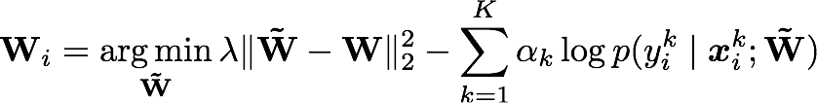
Inference (Prediction)
Local adaptation similar to MbPA (Sprechmann et al., 2018).
Retrain the copy on the retrieved examples
K nearest neighbors retrieval
Make a copy of itself
Notes:
Our model first retrieves simiarl examples from the memory using k-nearest neighbors

Slide 58

Inference (Prediction)
Local adaptation similar to MbPA (Sprechmann et al., 2018).
Retrain the copy on the retrieved examples
K nearest neighbors retrieval
Make a copy of itself
Use the retrained copy to predict
Notes:
Our model first retrieves simiarl examples from the memory using k-nearest neighbors

Slide 59
Experiments
Four question answering datasets.
SQuAD: Rajpurkar et al., 2016.
TriviaQA-Web: Joshi et al., 2017.
TriviaQA-Wiki: Joshi et al., 2017.
QuAC: Choi et al., 2018.
The contexts come from different domains (e.g., Wikipedia articles, web pages).
The questions are posed in different styles (e.g., information seeking, trivia questions).
Notes:
We evaluate this model on four QA datasets, presented sequentially. They come from different domains (Wikipedia articles, web pages), and the questions are posed in different styles. Some of them are information seeking dialog-style questions, some others are trivia questions.

Slide 60
Experiments
F1 scores (0-100), higher is better
F1 | Enc-Dec | A-GEM | MbPA | Ours | Multitask (upper bound)
QA | 53.1 | 56.2 | 60.3 | 62.4 | 67.8
A-GEM: Chaudhry et al., 2019
MbPA: Sprechmann et al., 2018
Notes:
== remove multitask maybe
This table summarizes our main results. There are more results in the paper if you are interested. The first column, encoder-decoder, is a standard neural network model that does not have any episodic memory. The next two columns, A-GEM and MbPA are baseline episodic memory models that use the examples differently than our method. MbPA++ is our model, which achieves the best score. The last column, multitask, is an upper bound on the performance if the model can see all examples at the same time. Basically this is a model that never forgets on these four datasets. We can see that while our model closes the gap, there is still some room for improvement to get to this upper bound performance.

Slide 61
Takeaways and Limitations
Episodic memory allows a language model to deal with changes in data distribution.
Notes:
Ok, so to summarize, I have shown that episodic memory allows a language model to deal with changes in training data distributions and protects previously learned knowledge.

Slide 62
Takeaways and Limitations
Episodic memory allows a language model to deal with changes in data distribution.
Linear space complexity in the number of examples, constant is more realistic.
% of stored examples in memory | 10% | 100%
Performance | 61.5 | 62.0
Notes:
However, there are still rooms for improvements. In particular, our model still has a linear space complexity for the memory module in the number of training examples. It means that as there are more training examples, the size of the memory grows linearly. We experimented with storing only a small percentage of the training examples in the memory. The performance drops, although not significantly. This indicates that it is possible to keep only a small number of examples, as long as we know which ones to keep. I think this is an exciting research problem.

Slide 63
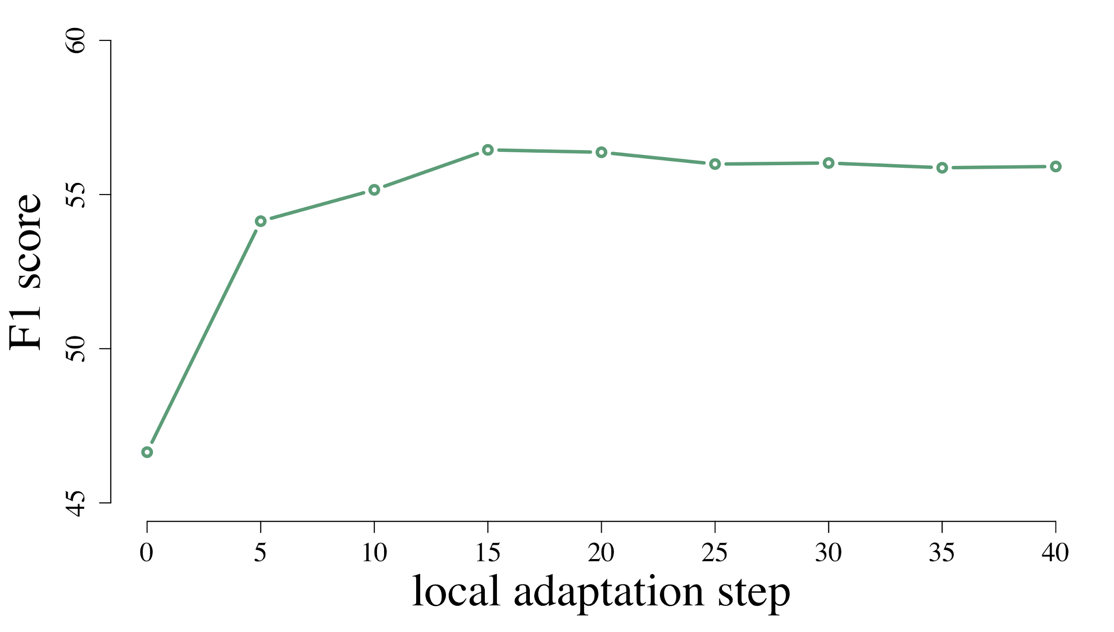
Takeaways and Limitations
Episodic memory allows a language model to deal with changes in data distribution.
Linear space complexity in the number of examples, constant is more realistic.
Local adaptation at inference time is computationally expensive.
% of stored examples in memory | 10% | 100%
Performance | 61.5 | 62.0
Notes:
Another limitation is that local adaptation is expensive since we have to do gradient-based minimization for each test example. We have some ideas around fast adaptation that we think would be promising to significantly cut down this adaptation time based on differentiable plasticity. Ok, so this is the end of the first part of my talk. Is there any question?

Slide 64
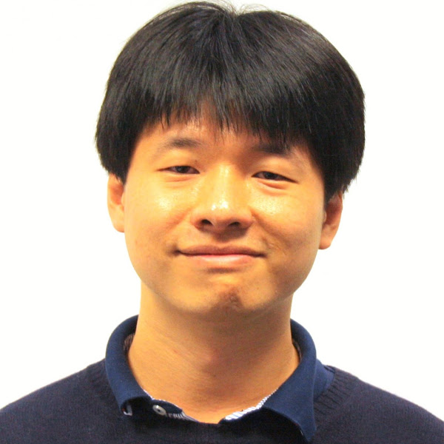
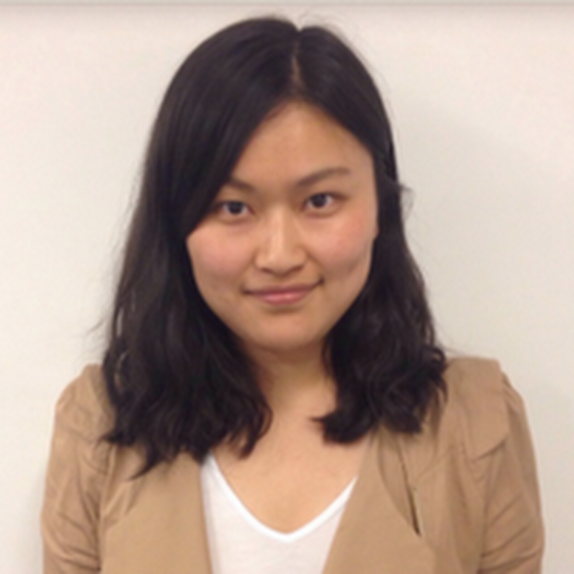
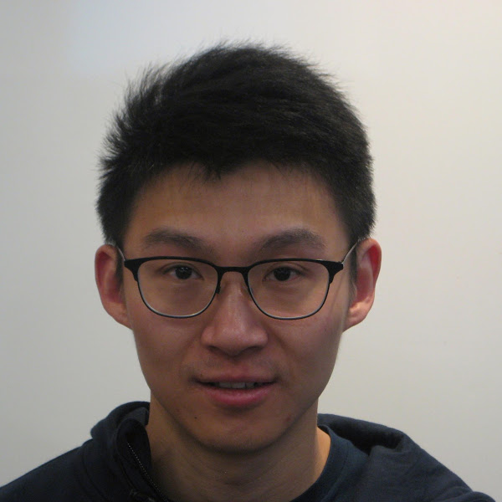
A Mutual Information Maximization Perspective of Language Representation Learning
Kong et al., ICLR 2020
Lingpeng
Cyprien
Wang
Lei
Zihang
Dani
Notes:
This is joint work with many colleagues at DeepMind, Lingpeng in particular.

Slide 65
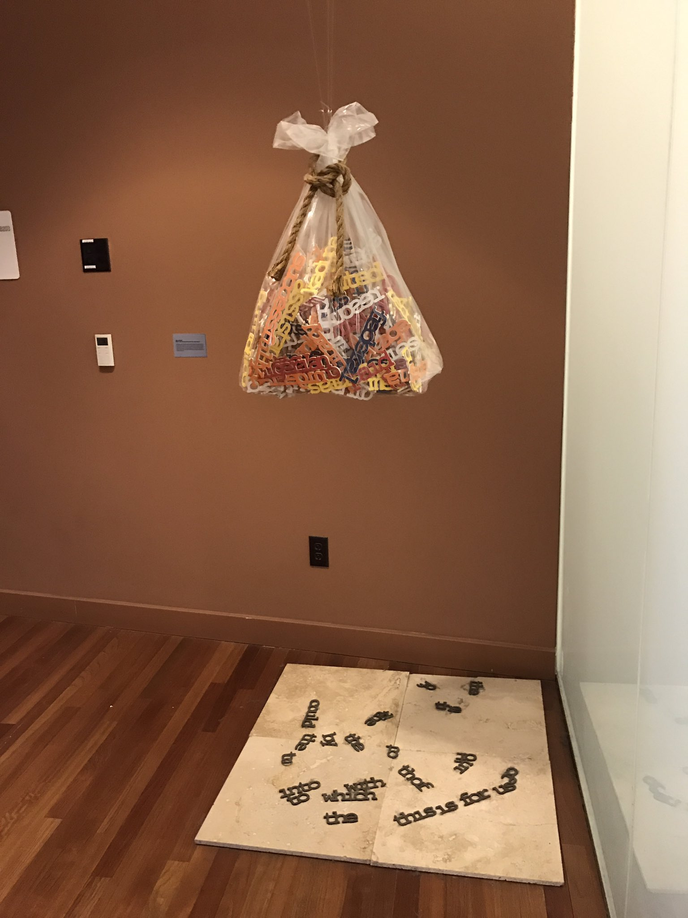
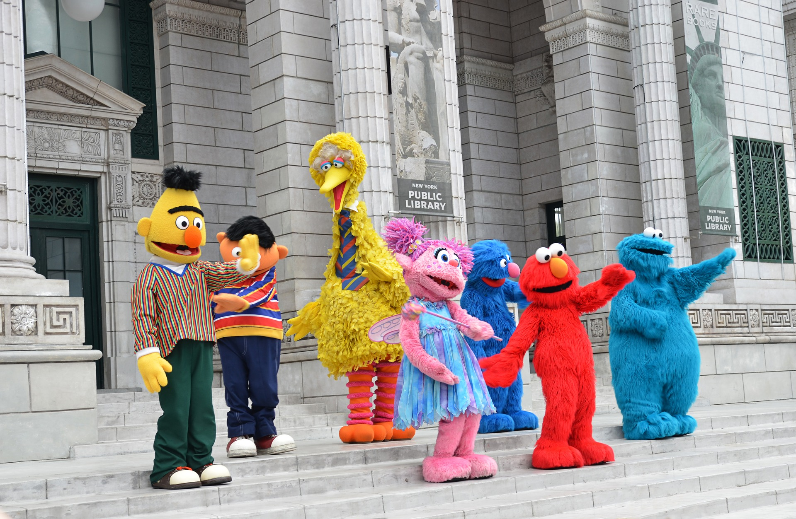
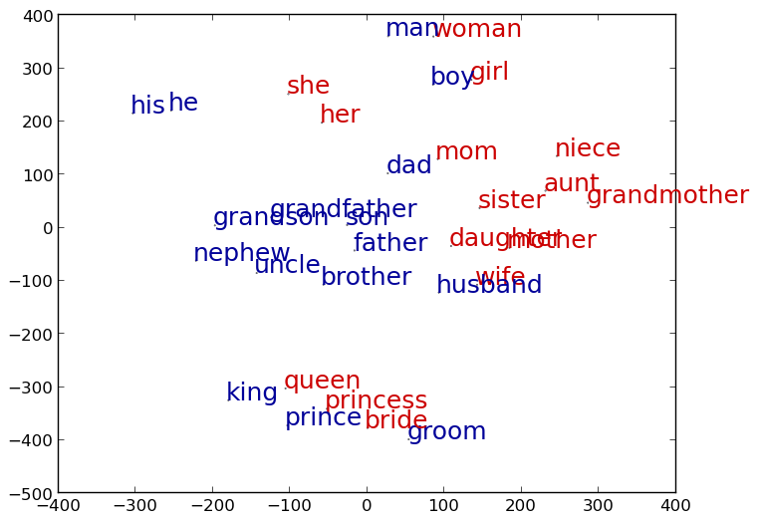
Text Representations
https://twitter.com/SmithaMilli/status/837153616116985856/
Bag of words
Word embeddings
Contextual word embeddings
Skip gram, Mikolov et al., 2013.
GloVe, Pennington et al., 2014.
ELMo, Peters et al., 2018.
BERT, Devlin et al., 2019.
XLNet, Yang et al., 2019.
Notes:
=== why we need representations
A little bit of background. NLP has progressed from using bag-of-words to word embeddings to contextual embeddings. This unsupervised training of word representations, now often referred to as self-supervised training, has been shown to produce better and better models for downstream tasks. It has also improved sample efficiency, as I showed earlier in the talk.

Slide 66
Text Representations
https://twitter.com/SmithaMilli/status/837153616116985856/
Hypothesis: these methods are different instances of one framework.
Bag of words
Word embeddings
Contextual word embeddings
Skip gram, Mikolov et al., 2013.
GloVe, Pennington et al., 2014.
ELMo, Peters et al., 2018.
BERT, Devlin et al., 2019.
XLNet, Yang et al., 2019.
Notes:
In this project, our hypothesis is that all these methods that have revolutionized the field in the last decade are instantiations of one framework.

Slide 67
Contrastive Learning
Main assumption: representations should capture similarity (Arora et al., 2019).
Notes:
What is this framework? It has many different names, but we will use the term contrastive learning, and more specifically the InfoNCE objective. This objective function is the main driver of progress in representation learning in pretty much all other fields besides NLP (computer vision, speech processing).

Slide 68




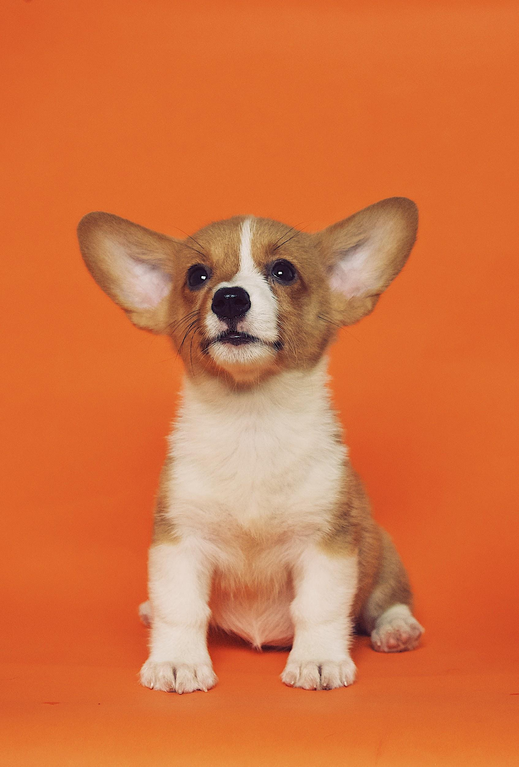


Contrastive Learning
Main assumption: representations should capture similarity (Arora et al., 2019).
Notes:
What is this framework? It has many different names, but we will use the term contrastive learning, and more specifically the InfoNCE objective. This objective function is the main driver of progress in representation learning in pretty much all other fields besides NLP (computer vision, speech processing).

Slide 69
Contrastive Learning
Main assumption: representations should capture similarity (Arora et al., 2019).
Human learning is continual.
Advances in ML have driven progress in NLP.
Logistic regression can be used for classification.
Transformer uses self attention.
There are many direct flights between London and Tokyo.
London Heathrow Terminal 5 is closed for maintenance.
Notes:
What is this framework? It has many different names, but we will use the term contrastive learning, and more specifically the InfoNCE objective. This objective function is the main driver of progress in representation learning in pretty much all other fields besides NLP (computer vision, speech processing).

Slide 70
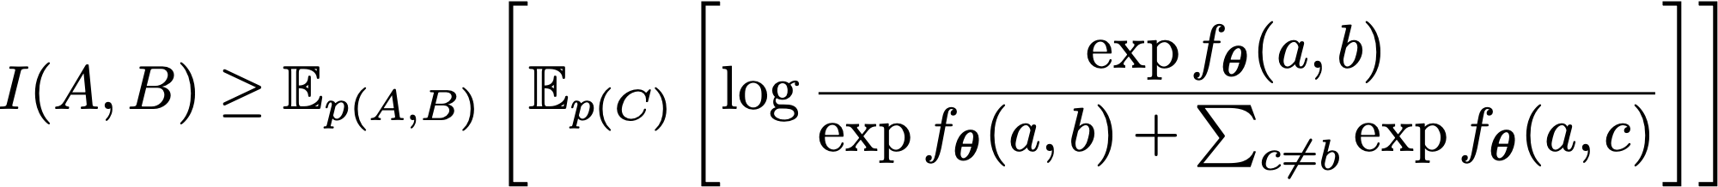
Contrastive Learning with InfoNCE
Main assumption: representations should capture similarity (Arora et al., 2019).
InfoNCE objective
Logeswaran and Lee, 2018 van den Oord, et al., 2019
Notes:
This is what the InfoNCE objective function looks like. It says that the mutual information between two random variables, A and B, are lower bounded by this equation on the right, which I will discuss in more details in the context of learning word representations.

Slide 71


Contrastive Learning with InfoNCE
Main assumption: representations should capture similarity (Arora et al., 2019).
InfoNCE objective
Logeswaran and Lee, 2018 van den Oord, et al., 2019
High when a and b go together
Notes:
This is what the InfoNCE objective function looks like. It says that the mutual information between two random variables, A and B, are lower bounded by this equation on the right, which I will discuss in more details in the context of learning word representations.

Slide 72
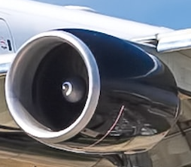
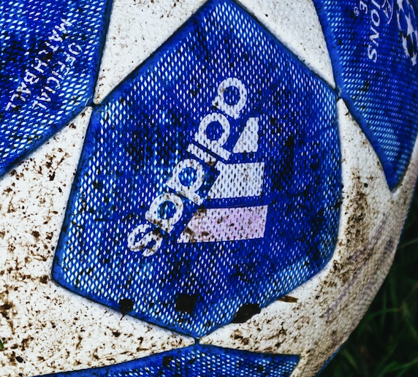
Contrastive Learning with InfoNCE
Main assumption: representations should capture similarity (Arora et al., 2019).
InfoNCE objective
Logeswaran and Lee, 2018 van den Oord, et al., 2019
Low when a and c do not go together
Notes:
This is what the InfoNCE objective function looks like. It says that the mutual information between two random variables, A and B, are lower bounded by this equation on the right, which I will discuss in more details in the context of learning word representations.

Slide 73
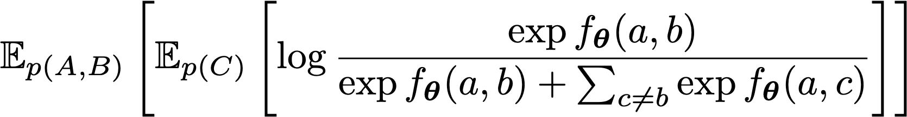
Contrastive Learning with InfoNCE
Carnegie Mellon University is located in Pittsburgh
Notes:
Suppose we have a sentence from our corpus, CMU is located in Pittsburgh. What are the A and B here? They are two different views of the sentence, and it is up to us as the designer of the representation learning method to decide what they are.

Slide 74

Contrastive Learning with InfoNCE
Carnegie Mellon University is located in Pittsburgh
Notes:
For example, we can choose A and B to be two words in the sentence, Mellon on located.

Slide 75
Contrastive Learning with InfoNCE
Carnegie Mellon University is located in Pittsburgh
Notes:
Alternatively, we could consider B to be located and A every other word in the sentence besides located.

Slide 76
Contrastive Learning with InfoNCE
Carnegie Mellon University is located in Pittsburgh
Notes:
Another example would be using CMU as A and Pittsburgh as B.

Slide 77
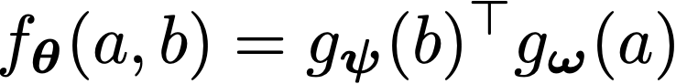
Contrastive Learning with InfoNCE
Carnegie Mellon University is located in Pittsburgh
Notes:
After we choose our two views of the sentence, we encode them using a function g_psi and g_omega. That would represent the f(a,b) part of the equation. Again, it is up to us as the designer of the method to decide what functions we would like to use as g_psi and g_omega

Slide 78
Contrastive Learning with InfoNCE
Tokyo
London
dog
cat
Carnegie Mellon University is located in Pittsburgh
Notes:
The equation also has a denominator, which basically says that we need negative samples of B to be paired up with A drawn from a proposal distribution. For example, this could be other words in the vocabulary that is not Pittsburgh. Given all these ingredients, we can then compute this term. The inner expectation just means that we need to consider different sets for negative samples, and the outer expectation means that we keep repeating this process over many sentences in the corpus. At the end of training, our representation learning model is either g_psi and g_omega, whichever one we choose. So this is a contrastive learning framework for representation learning.

Slide 79
Contrastive Learning with InfoNCE
Carnegie Mellon University is located in Pittsburgh

Slide 80
Contrastive Learning with InfoNCE
Carnegie Mellon University is located in Pittsburgh

Slide 81
Contrastive Learning with InfoNCE
Carnegie Mellon University is located in Pittsburgh
Notes:
The inner expectation just means that we need to consider different sets for negative samples, and the outer expectation means that we keep repeating this process over many sentences in the corpus. At the end of training, our representation learning model is either g_psi and g_omega, whichever one we choose. So this is a contrastive learning framework for representation learning. It turns out, this is a general framework that unifies all previous methods for learning word embeddings.

Slide 82
Contrastive Learning with InfoNCE
Harvard University is located in Cambridge
Notes:
Suppose we have a sentence from our corpus, CMU is located in Pittsburgh. What are the A and B here? They are two different views of the sentence, and it is up to us as the designer of the representation learning method to decide what they are.

Slide 83
Contrastive Learning with InfoNCE
Harvard University is located in Cambridge
Notes:
For example, we can choose A and B to be two words in the sentence, Mellon on located.

Slide 84
Contrastive Learning with InfoNCE
Harvard University is located in Cambridge
Notes:
For example, we can choose A and B to be two words in the sentence, Mellon on located.

Slide 85
Contrastive Learning with InfoNCE
Harvard University is located in Cambridge
Notes:
For example, we can choose A and B to be two words in the sentence, Mellon on located.

Slide 86
Contrastive Learning with InfoNCE
Harvard University is located in Cambridge
Notes:
For example, we can choose A and B to be two words in the sentence, Mellon on located.

Slide 87
Contrastive Learning with InfoNCE
Tokyo
London
dog
cat
Harvard University is located in Cambridge
Notes:
For example, we can choose A and B to be two words in the sentence, Mellon on located.

Slide 88
Contrastive Learning with InfoNCE
Harvard University is located in Cambridge
Notes:
For example, we can choose A and B to be two words in the sentence, Mellon on located.

Slide 89
Contrastive Learning with InfoNCE
Harvard University is located in Cambridge
Notes:
For example, we can choose A and B to be two words in the sentence, Mellon on located.

Slide 90
Contrastive Learning with InfoNCE
Harvard University is located in Cambridge
Notes:
For example, we can choose A and B to be two words in the sentence, Mellon on located.

Slide 91
Skip-gram
Mikolov et al., 2013
Carnegie Mellon University is located in Pittsburgh
Notes:
For example, for skip-gram, given the same sentence CMU is located in Pittsburgh

Slide 92

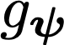


Skip-gram
Mikolov et al., 2013
Carnegie Mellon University is located in Pittsburgh
Notes:
Here, A and B are two words within a window size in the sentence, and g_psi and g_omega are word embedding lookup functions.

Slide 93
Skip-gram
Mikolov et al., 2013
Carnegie Mellon University is located in Pittsburgh
Noise Contrastive Estimation for learning word embeddings (Mnih and Kavukcuoglu, 2013)
Notes:
Here, A and B are two words within a window size in the sentence, and g_psi and g_omega are word embedding lookup functions.

Slide 94
BERT
Devlin et al., 2019
Carnegie Mellon University is located in Pittsburgh
Notes:
Now let us talk about BERT
== make it not as trivial

Slide 95
BERT
Devlin et al., 2019
Carnegie Mellon University is located in Pittsburgh
Notes:
Here, B is a masked word, and g_psi is a word embedding lookup function.

Slide 96

BERT
Devlin et al., 2019
Carnegie Mellon University is located in Pittsburgh
Vaswani et al., 2017
Notes:
A, on the other hand, is the rest of the context, with the word which is chosen as B replaced by as mask token. The entire sequence is then encoded using a transformer. We can see now the main difference between skipgram and BERT is what is chosen as the second view of the sentence (A) and how we encode it (transformer vs. word embedding lookup).

Slide 97
Skip-gram
Mikolov et al., 2013
Harvard University is located in Cambridge
Notes:
For example, for skip-gram, given the same sentence CMU is located in Pittsburgh

Slide 98
Skip-gram
Mikolov et al., 2013
Harvard University is located in Cambridge
Notes:
Here, A and B are two words within a window size in the sentence, and g_psi and g_omega are word embedding lookup functions.

Slide 99
Skip-gram
Mikolov et al., 2013
Harvard University is located in Cambridge
Noise Contrastive Estimation for learning word embeddings (Mnih and Kavukcuoglu, 2013)
Notes:
Here, A and B are two words within a window size in the sentence, and g_psi and g_omega are word embedding lookup functions.

Slide 100
BERT
Devlin et al., 2019
Harvard University is located in Cambridge
Notes:
Now let us talk about BERT.

Slide 101
BERT
Devlin et al., 2019
Harvard University is located in Cambridge
Notes:
Here, B is a masked word, and g_psi is a word embedding lookup function.

Slide 102
BERT
Devlin et al., 2019
Harvard University is located in Cambridge
Vaswani et al., 2017
Notes:
A, on the other hand, is the rest of the context, with the word which is chosen as B replaced by as mask token. The entire sequence is then encoded using a transformer. We can see now the main difference between skipgram and BERT is what is chosen as the second view of the sentence (A) and how we encode it (transformer vs. word embedding lookup).

Slide 103


Why is this interesting?
A framework that unifies classical and modern word embedding methods.
Skip-gram | word | word | lookup | lookup
BERT | context | word | transformer | lookup
XLNet | context | word | TXL++ | lookup
Mikolov et al., 2013
Devlin et al., 2019
Yang et al., 2019
Notes:
Why is this interesting? First of all, this is a framework that unifies half a decade of progress in NLP. We can also consider XLNet, a recent innovation by researchers at CMU here, under this framework where we simply choose a different g_omega (please see the paper for details).

Slide 104
Why is this interesting?
A framework that unifies classical and modern word embedding methods.
Skip-gram | word | word | lookup | lookup
BERT | context | word | transformer | lookup
XLNet | context | word | TXL++ | lookup
Mikolov et al., 2013
Devlin et al., 2019
Yang et al., 2019
Connections to representation learning methods used in other domains (vision, speech).
Notes:
In addition, since this is THE framework used in other domains, we can now see how word representation learning models are related to image representation learning models.

Slide 105
Why is this interesting?
A framework that unifies classical and modern word embedding methods.
Skip-gram | word | word | lookup | lookup
BERT | context | word | transformer | lookup
XLNet | context | word | TXL++ | lookup
Mikolov et al., 2013
Devlin et al., 2019
Yang et al., 2019
Connections to representation learning methods used in other domains (vision, speech).
A better understanding on how to construct new self-supervised tasks.
Notes:
And lastly, this framework provides a better understanding that could help us construct new self-supervised tasks. I will illustrate the last two points by taking an inspiration from a popular representation learning method in computer vision to construct a new self-supervised task for language learning.

Slide 106

Model
Deep InfoMax (DIM; Hjelm et al., 2019)
Notes:
Our model is called InfoWord. But here, I have an image from a computer vision paper where they presented a method called DeepInfoMax or DIM. DIM learns a representation of an image using contrastive learning. Here, given an image in green, it creates a global feature and a local feature, which are A and B in our previous notations. It then uses features drawn from another image as the negative samples for B. They can generate many negative samples by using many other images. DIM is no longer state-of-the-art as of today, but we will use their idea of a global and local feature to design our improved word representation learning model called InfoWord.

Slide 107
Model
Deep InfoMax (DIM; Hjelm et al., 2019)
Notes:
Our model is called InfoWord. But here, I have an image from a computer vision paper where they presented a method called DeepInfoMax or DIM. DIM learns a representation of an image using contrastive learning. Here, given an image in green, it creates a global feature and a local feature, which are A and B in our previous notations. It then uses features drawn from another image as the negative samples for B. They can generate many negative samples by using many other images. DIM is no longer state-of-the-art as of today, but we will use their idea of a global and local feature to design our improved word representation learning model called InfoWord.

Slide 108
Model
Deep InfoMax (DIM; Hjelm et al., 2019)
Notes:
Our model is called InfoWord. But here, I have an image from a computer vision paper where they presented a method called DeepInfoMax or DIM. DIM learns a representation of an image using contrastive learning. Here, given an image in green, it creates a global feature and a local feature, which are A and B in our previous notations. It then uses features drawn from another image as the negative samples for B. They can generate many negative samples by using many other images. DIM is no longer state-of-the-art as of today, but we will use their idea of a global and local feature to design our improved word representation learning model called InfoWord.

Slide 109
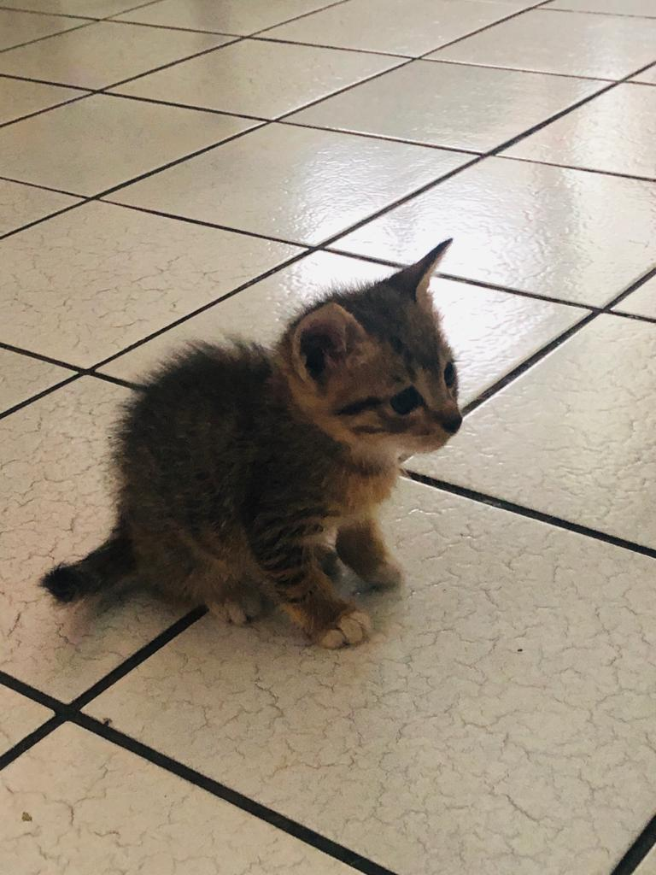
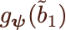
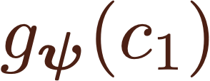
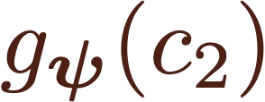
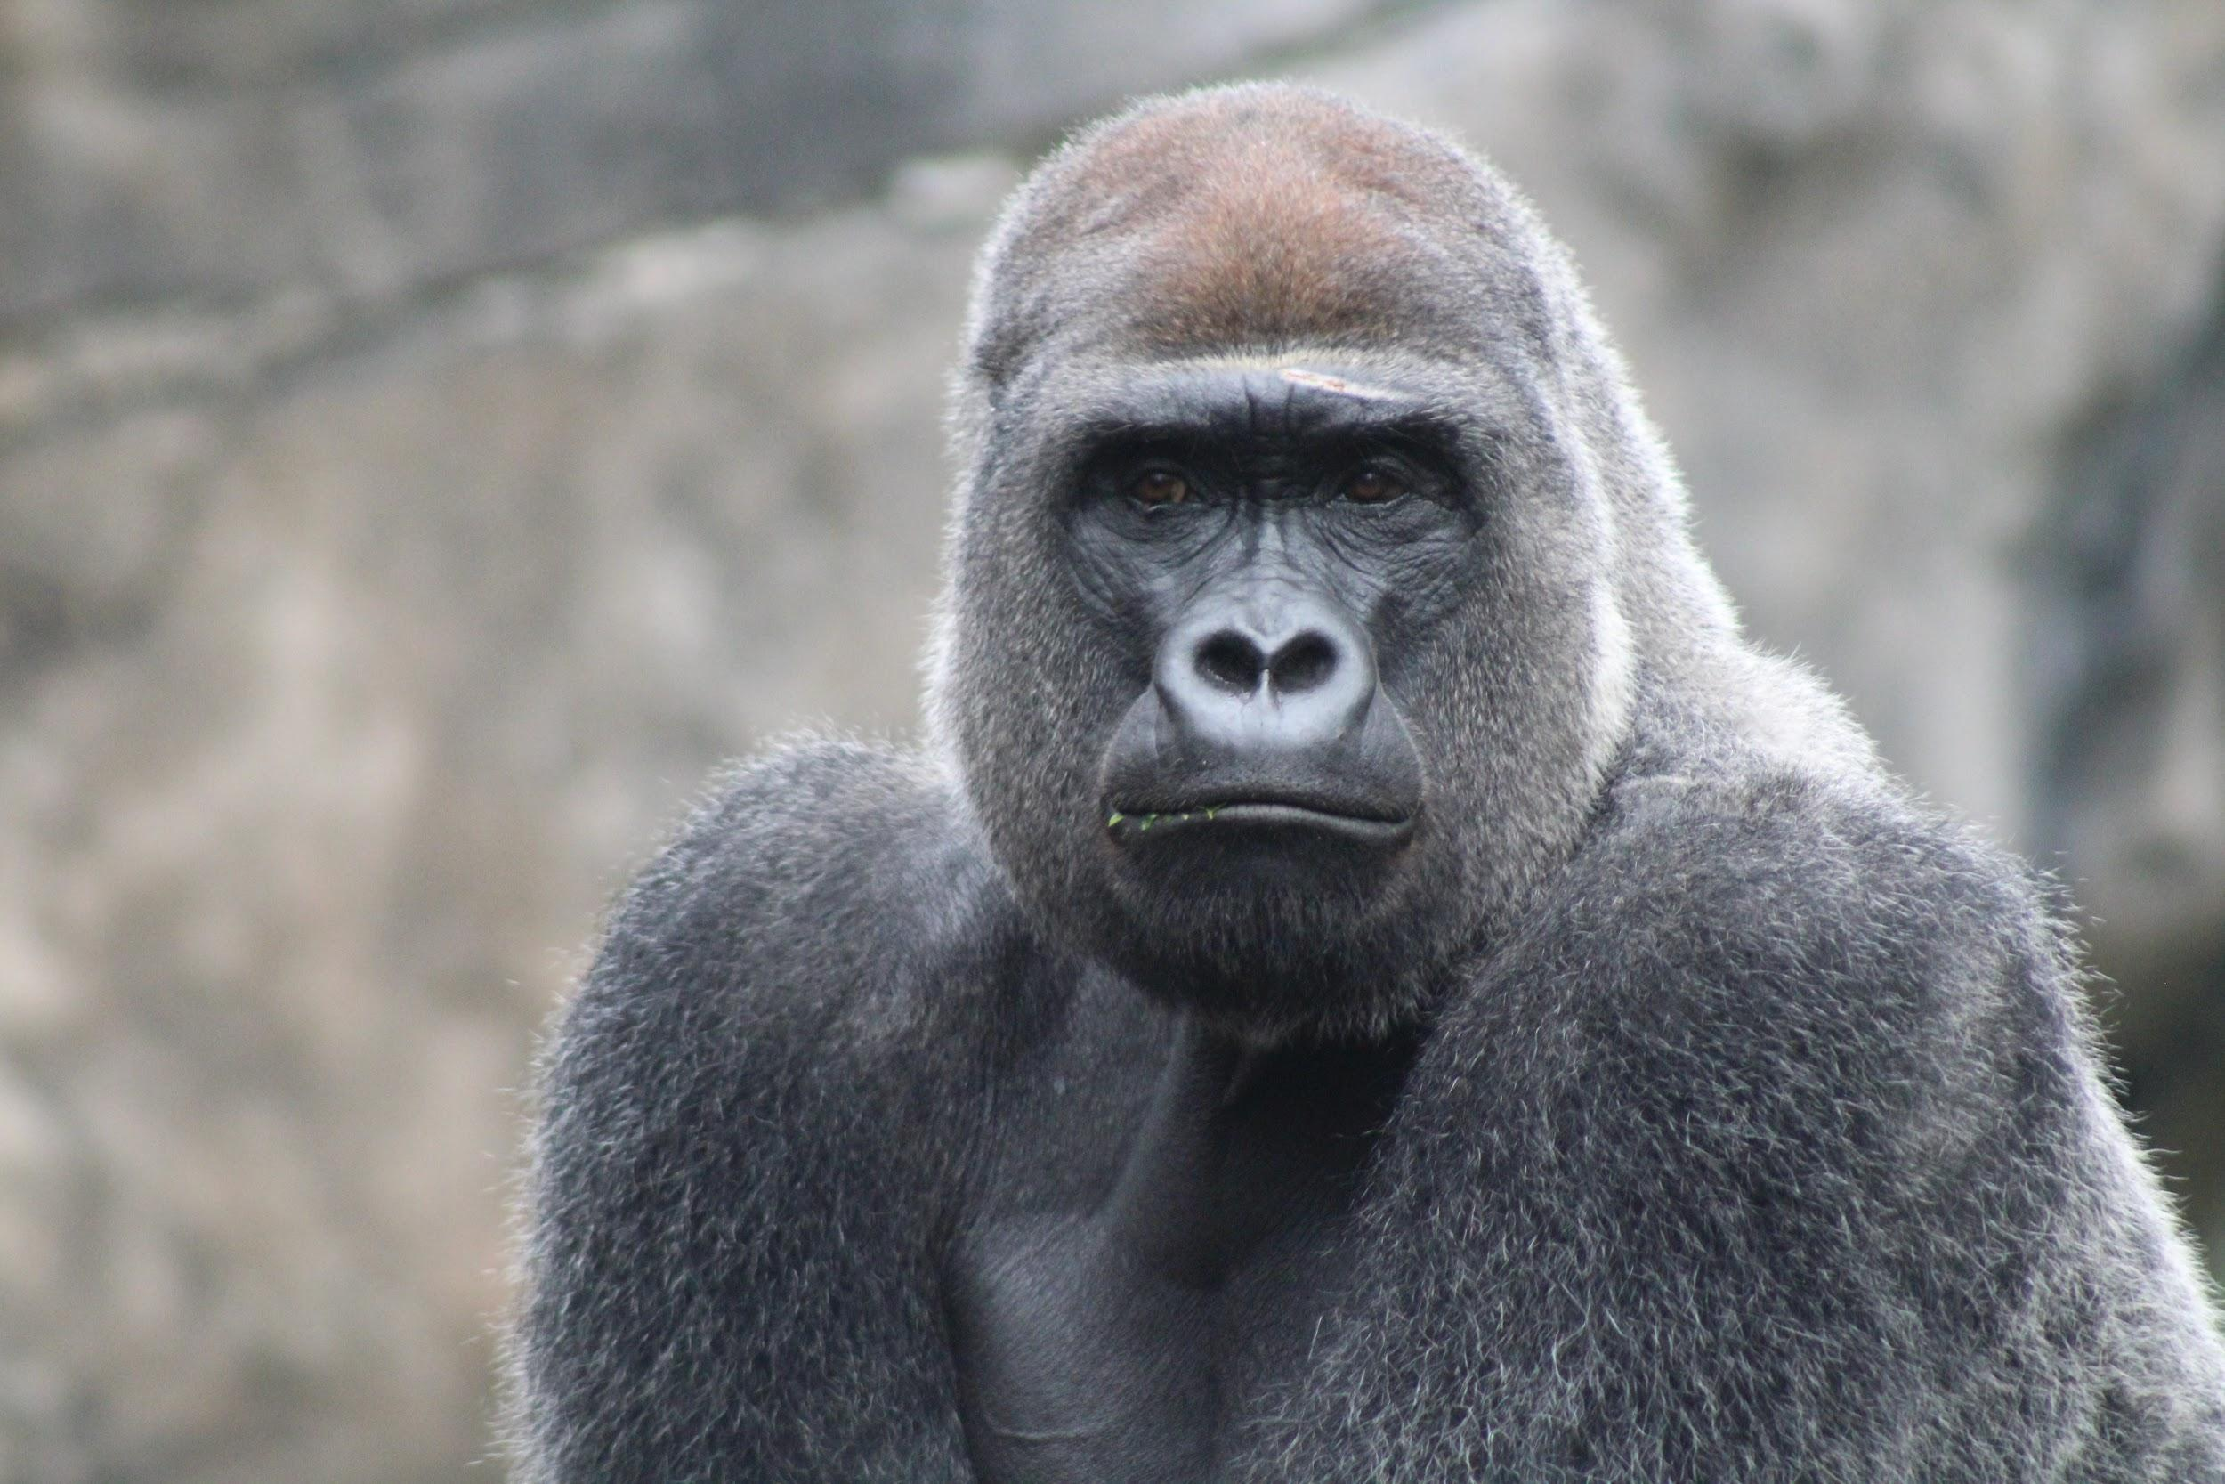
Model
Deep InfoMax (DIM; Hjelm et al., 2019)
Notes:
Our model is called InfoWord. But here, I have an image from a computer vision paper where they presented a method called DeepInfoMax or DIM. DIM learns a representation of an image using contrastive learning. Here, given an image in green, it creates a global feature and a local feature, which are A and B in our previous notations. It then uses features drawn from another image as the negative samples for B. They can generate many negative samples by using many other images. DIM is no longer state-of-the-art as of today, but we will use their idea of a global and local feature to design our improved word representation learning model called InfoWord.

Slide 110
Model
Deep InfoMax (DIM; Hjelm et al., 2019)
Notes:
Our model is called InfoWord. But here, I have an image from a computer vision paper where they presented a method called DeepInfoMax or DIM. DIM learns a representation of an image using contrastive learning. Here, given an image in green, it creates a global feature and a local feature, which are A and B in our previous notations. It then uses features drawn from another image as the negative samples for B. They can generate many negative samples by using many other images. DIM is no longer state-of-the-art as of today, but we will use their idea of a global and local feature to design our improved word representation learning model called InfoWord.

Slide 111
Model
Deep InfoMax (DIM; Hjelm et al., 2019)
Carnegie Mellon University is located in Pittsburgh
Notes:
Supposed we have our favorite sentence again, CMU is located in Pittsburgh.

Slide 112
Model
Deep InfoMax (DIM; Hjelm et al., 2019)
Carnegie Mellon University is located in Pittsburgh
Notes:
The local feature in DIM are regions of an image. The analog of this in sentences are n-grams in a sentence. For example, we can take this n-gram for illustration, is located in. We then encode this n-gram using a transformer. Note the key difference between all previous methods I talk about before, including BERT and XLNET. Here, B actually consists of multiple words (trigrams), whereas previously they are always a single word that is encoded using a word embedding lookup function. This is a key difference that is only possible within the framework of contrastive learning. <maybe do not say this since too much detail> since otherwise we need to marginalize over all negative samples (instead of sampling), and the number of negative samples grows polynomially with the length of B.

Slide 113
Model
Deep InfoMax (DIM; Hjelm et al., 2019)
Carnegie Mellon University is located in Pittsburgh
Notes:
We consider the global representation of the sentence to be a transformer encoded representation of the entire sentence, with appropriate masking. Now we have both g_omega(a) and g_psi(b), all we need are just some negative samples to be contrasted with B.

Slide 114
Model
Deep InfoMax (DIM; Hjelm et al., 2019)
Carnegie Mellon University is located in Pittsburgh
Starcraft II is a fun game
Cristiano Ronaldo scores an own goal
Machine learning is transforming drug discovery
Notes:
We can take other sentences in the corpus, similar to taking other images. Suppose we take 3 other sentences.

Slide 115
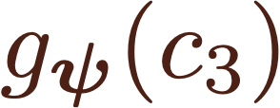
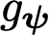
Model
Deep InfoMax (DIM; Hjelm et al., 2019)
Carnegie Mellon University is located in Pittsburgh
Starcraft II is a fun game
Cristiano Ronaldo scores an own goal
Machine learning is transforming drug discovery
Notes:
We then take random n-grams of the same length as B from other sentences, which are three words, and obtain representations of the negative samples.

Slide 116
Model
Deep InfoMax (DIM; Hjelm et al., 2019)
Carnegie Mellon University is located in Pittsburgh
Starcraft II is a fun game
Cristiano Ronaldo scores an own goal
Machine learning is transforming drug discovery
Notes:
After this, we have everything we need to optimize the InfoNCE objective function with appropriate A, B, and negative samples. The equation looks scary, but this is the previous InfoNCE objective that essentially is just computing a bunch of dot products between these five representations.

Slide 117
Model
Deep InfoMax (DIM; Hjelm et al., 2019)
Carnegie Mellon University is located in Pittsburgh
Starcraft II is a fun game
Cristiano Ronaldo scores an own goal
Machine learning is transforming drug discovery
Notes:
Our final objective interpolates between a standard masked language modeling objective used in BERT and this new self-supervised task that we derived from DIM, where lambda MLM and lambda DIM are tunable weighting constants.

Slide 118
Model
Deep InfoMax (DIM; Hjelm et al., 2019)
Harvard University is located in Cambridge
Notes:
Supposed we have our favorite sentence again, CMU is located in Pittsburgh.

Slide 119
Model
Deep InfoMax (DIM; Hjelm et al., 2019)
Harvard University is located in Cambridge
Notes:
The local feature in DIM are regions of an image. The analog of this in sentences are n-grams in a sentence. For example, we can take this n-gram for illustration, is located in. We then encode this n-gram using a transformer. Note the key difference between all previous methods I talk about before, including BERT and XLNET. Here, B actually consists of multiple words (trigrams), whereas previously they are always a single word that is encoded using a word embedding lookup function. This is a key difference that is only possible within the framework of contrastive learning. <maybe do not say this since too much detail> since otherwise we need to marginalize over all negative samples (instead of sampling), and the number of negative samples grows polynomially with the length of B.

Slide 120
Model
Deep InfoMax (DIM; Hjelm et al., 2019)
Harvard University is located in Cambridge
Notes:
We consider the global representation of the sentence to be a transformer encoded representation of the entire sentence, with appropriate masking. Now we have both g_omega(a) and g_psi(b), all we need are just some negative samples to be contrasted with B.

Slide 121
Model
Deep InfoMax (DIM; Hjelm et al., 2019)
Harvard University is located in Cambridge
Starcraft II is a fun game
Cristiano Ronaldo scores an own goal
Machine learning is transforming drug discovery
Notes:
We can take other sentences in the corpus, similar to taking other images. Suppose we take 3 other sentences.

Slide 122
Model
Deep InfoMax (DIM; Hjelm et al., 2019)
Harvard University is located in Cambridge
Starcraft II is a fun game
Cristiano Ronaldo scores an own goal
Machine learning is transforming drug discovery
Notes:
We then take random n-grams of the same length as B from other sentences, which are three words, and obtain representations of the negative samples.

Slide 123
Model
Deep InfoMax (DIM; Hjelm et al., 2019)
Harvard University is located in Cambridge
Starcraft II is a fun game
Cristiano Ronaldo scores an own goal
Machine learning is transforming drug discovery
Notes:
After this, we have everything we need to optimize the InfoNCE objective function with appropriate A, B, and negative samples. The equation looks scary, but this is the previous InfoNCE objective that essentially is just computing a bunch of dot products between these five representations.

Slide 124
Model
Deep InfoMax (DIM; Hjelm et al., 2019)
Harvard University is located in Cambridge
Starcraft II is a fun game
Cristiano Ronaldo scores an own goal
Machine learning is transforming drug discovery
Notes:
Our final objective interpolates between a standard masked language modeling objective used in BERT and this new self-supervised task that we derived from DIM, where lambda MLM and lambda DIM are tunable weighting constants.

Slide 125
Experiments
Question answering on SQuAD (Rajpurkar et al., 2016).
F1 |  | F1
Small Model | BERT | 90.9
 | Ours | 91.4
Large Model | BERT | 92.7
 | Ours | 93.1
F1 score (0-100), higher is better.
BERT: Devlin et al., 2019.
Notes:
How does this model perform? Here, we have some results on question answering on SQuAD. BERT is the baseline model, and InfoWord is the same model with the addition of a new task. But it is clear that it improves the performance over a baseline BERT model, both for a small and a large model.

Slide 126
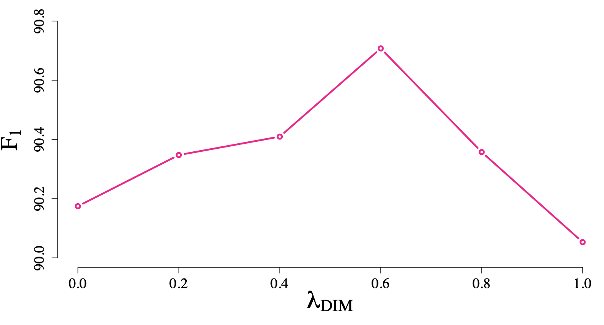
Experiments
Question answering on SQuAD (Rajpurkar et al., 2016).
F1 |  | F1
Small Model | BERT | 90.9
 | Ours | 91.4
Large Model | BERT | 92.7
 | Ours | 93.1
F1 score (0-100), higher is better.
BERT: Devlin et al., 2019.
Notes:
== change I MLM maybe
I have another plot here that shows the benefit of the new pretraining task. Remember that our final objective function is an interpolation between two terms. Here, we can see that as we increase the contribution of the new task, the performance goes up, but if there is too much contribution it starts going down again. Again, there are more experiments and numbers in the paper if you are interested in knowing more.

Slide 127
Takeaways and Limitations
Progress in language representation learning has largely been driven by advances in model architectures.
It is possible to transfer ideas across domains when designing self-supervised tasks.
Notes:
Okay, to conclude the second part of the talk, a key takeaway are that progress in NLP has largely been driven by using more sophisticated functions to represent the encoder g_psi and g_omega. Another takeaway is that it is now possible to transfer ideas across domains when designing self-supervised tasks due to our framework. I think connecting these different areas are important and would result in faster progress in each of them.

Slide 128
Takeaways and Limitations
Progress in language representation learning has largely been driven by advances in model architectures.
It is possible to transfer ideas across domains when designing self-supervised tasks.
All variants of existing models, fail to incorporate global context (they rely on local views).
Notes:
Our model is still not perfect. One limitation that I think could be improved is that all of these models still only consider different parts of a sentence as the two views. These are local views, and incorporating global context from other sentences in the corpus could be key to next generation models. Before I get into future directions, is there any question?

Slide 129
Future Directions
A language model that continually learns in an efficient way to perform multiple complex tasks in many languages.
Notes:
In the next 2-5 years, I plan to continue working on similar areas I have been working on so far and expand to a few more. I have 3 specific things I will talk about today.

Slide 130
Future Directions
A language model that continually learns in an efficient way to perform multiple complex tasks in many languages.
Generative Models
Notes:
The second area that I think is important is generative models. When I talk about generative models, I do not only mean language generation, but also how the principle of generative learning is more attractive than discriminative training. We work a lot on generative models as well, although I did not get a chance to talk about them today. I think generative models can elegantly deal with multiple tasks. For example, I have a language model, and anybody can trigger it to produce a response as long as they know how to query my language model. They can ask me questions, tell me to do stuffs, and others. Generative models has also been shown to be more sample efficient or approach their asymptotic error faster, and is important for planning.

Slide 131
Future Directions
A language model that continually learns in an efficient way to perform multiple complex tasks in many languages.
Generative Models
Notes:
The second area that I think is important is generative models. When I talk about generative models, I do not only mean language generation, but also how the principle of generative learning is more attractive than discriminative training. We work a lot on generative models as well, although I did not get a chance to talk about them today. I think generative models can elegantly deal with multiple tasks. For example, I have a language model, and anybody can trigger it to produce a response as long as they know how to query my language model. They can ask me questions, tell me to do stuffs, and others. Generative models has also been shown to be more sample efficient or approach their asymptotic error faster, and is important for planning.

Slide 132
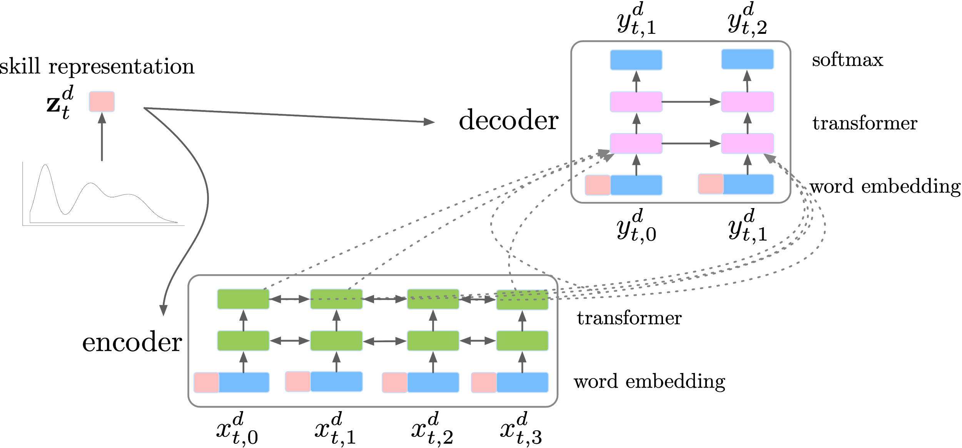
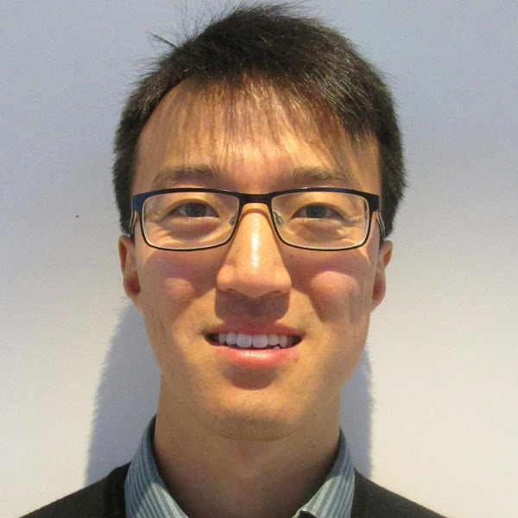
Future Directions
Modelling Latent Skills for Multitask Language Generation
A language model that continually learns in an efficient way to perform multiple complex tasks in many languages.
Generative Models
Cao and Yogatama, arXiv 2020
Kris
Dani
Notes:
Within generative models, I am excited to explore hierachical models for efficient out-of-distribution generalization.
Kris Cao and I had a recent paper that we put up on arXiv a week ago. In this model of multitask language generation, we first sample a skill that is needed to solve a task, and then use it to customize our language generation model for a particular task. There are so many more things that could be done in this space and our paper is just a first step in this direction.

Slide 133
Future Directions
A language model that continually learns in an efficient way to perform multiple complex tasks in many languages.
Memory
Notes:
The first one is continuing my work on semi-parametric models. I like to use this term to refer to models that combine a big parametric neural network with non parametric components such as memory blocks and cache. Human memory implements different systems for different functions. I believe the separation of compute and storage is a necessary architectural bias in a machine learning model as well. I also think memory is key to allow for complex reasoning.

Slide 134


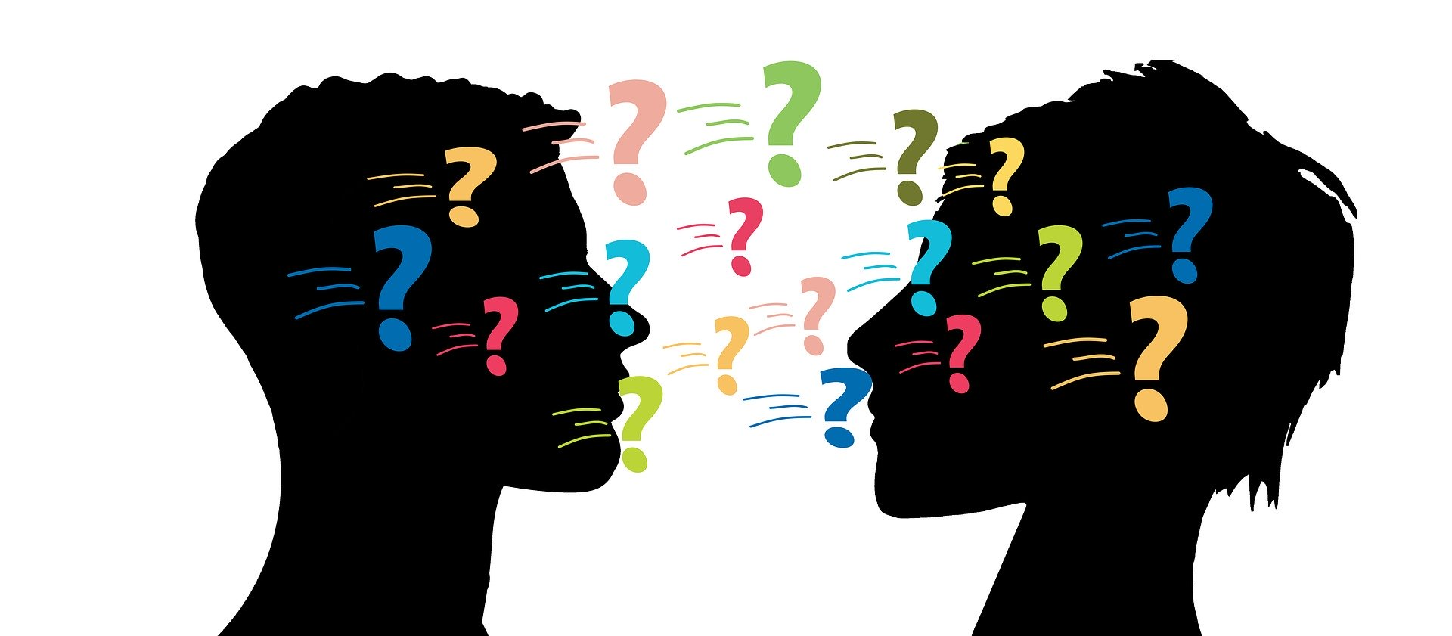

Future Directions
A language model that continually learns in an efficient way to perform multiple complex tasks in many languages.
Memory
Working
Procedural
Semantic
Episodic
Notes:
The first one is continuing my work on semi-parametric models. I like to use this term to refer to models that combine a big parametric neural network with non parametric components such as memory blocks and cache. Human memory has specialized systems for different functions. I believe the separation of compute and storage is a necessary architectural bias in a machine learning model as well. I also think memory is key to allow for complex reasoning.

Slide 135
Future Directions
A language model that continually learns in an efficient way to perform multiple complex tasks in many languages.
Memory
Working
Procedural
Semantic
Episodic
Notes:
The first one is continuing my work on semi-parametric models. I like to use this term to refer to models that combine a big parametric neural network with non parametric components such as memory blocks and cache. Human memory has specialized systems for different functions. I believe the separation of compute and storage is a necessary architectural bias in a machine learning model as well. I also think memory is key to allow for complex reasoning.

Slide 136
Future Directions
A language model that continually learns in an efficient way to perform multiple complex tasks in many languages.
Representation Learning
Notes:
I am also excited to work more on learning language independent representations. We know that humans acquire language with a mechanism that is language independent, and the abstractions we learn generalize to other languages. I believe we can take inspirations from this to learn generalizable abstractions for machines as well.

Slide 137
Future Directions
A language model that continually learns in an efficient way to perform multiple complex tasks in many languages.
Representation Learning
Indonesian
日本語
English
Notes:
I am also excited to work more on learning language independent representations. We know that humans acquire language with a mechanism that is language independent, and the abstractions we learn generalize to other languages. I believe we can take inspirations from this to learn generalizable abstractions for machines as well.

Slide 138

Future Directions
On the Crosslingual Transferability of Monolingual Representations
A language model that continually learns in an efficient way to perform multiple complex tasks in many languages.
Representation Learning
Artetxe et al., arXiv 2019
Mikel
Sebastian
Dani
Notes:
In this area, Mikel, Sebastian and I had a recent paper under review where we show that deep models that learn on English data can generalize to other languages once it learns the lexical representations of the other languages. Not only learning multilingual representations, but using this insight to let us design better models.

Slide 139
Future Directions
A language model that continually learns in an efficient way to perform multiple complex tasks in many languages.
Memory
Representation Learning
Generative Models
Notes:
Finally, I see these three lines of research to merge into one.

Slide 140
Future Directions
A language model that continually learns in an efficient way to perform multiple complex tasks in many languages.
Memory
Representation Learning
Generative Models
Notes:
Where we see a generative memory-augmented language model that generalize efficiently to many tasks and many languages after it learns its representations in an unsupervised fashion, similar to how humans learn.

Slide 141

Future Directions
A language model that continually learns in an efficient way to perform multiple complex tasks in many languages.
Memory
Representation Learning
Generative Models
Notes:
Where we see a generative memory-augmented language model that generalize efficiently to many tasks and many languages after it learns its representations in an unsupervised fashion, similar to how humans learn.

Slide 142

https://dyogatama.github.io
dyogatama@google.com
Notes:
Ok, so that is it from me. Thank you so much for your time and I would be happy to take questions.

Slide 143
General Linguistic Intelligence
The ability to acquire, store, and reuse knowledge (about a language’s lexicon, syntax, semantics, and pragmatic conventions) from textual data to adapt to new tasks quickly without forgetting old ones.
Notes:
In this talk, I will discuss our research toward general linguistic intelligence. GLI is a very broad term, but I will limit our scope by using the following definition: the ability to acquire, store, and reuse knowledge from text to adapt to new tasks quickly without forgetting old ones.
To be more concrete, we can imagine an agent that continually learn by reading everything on the web and is able to perform multiple tasks such as answering questions and summarization, in all languages. Importantly, it should be able to reason and make inferences about new things. For example, if it has read all arxiv papers, we could ask what method is possibly good to solve problem X. This is beyond the capability of existing question answering systems that work well on factual questions that do not require complex reasoning.

Slide 144
Future Directions
The future is generative (models).
Elegantly deal with multiple tasks (McCann et al., 2018; Radford et al., 2019).
Approach their asymptotic error faster (Yogatama et al., arXiv 2017).
Crucial to imagination and planning (Weber et al., 2017).

Slide 145
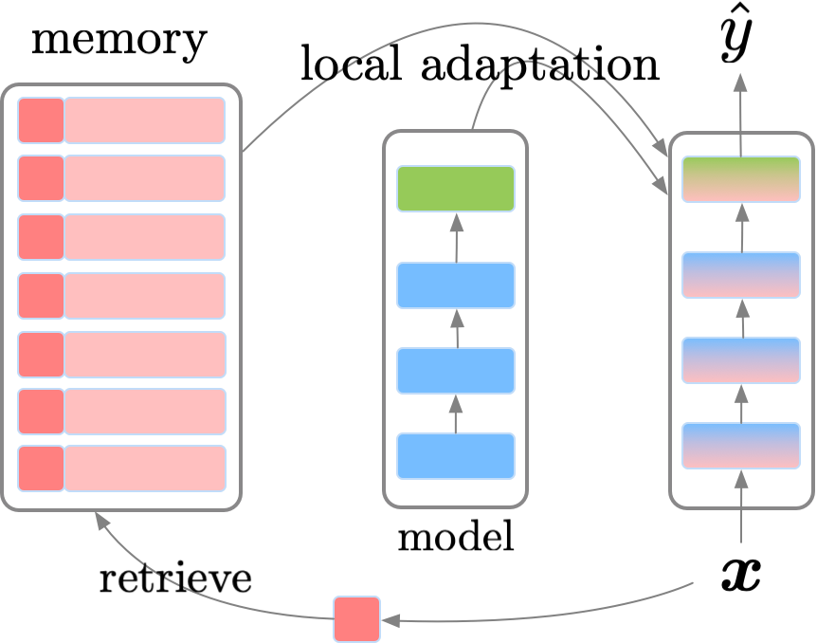
Inference (Prediction)
Local adaptation similar to MbPA (Sprechmann et al., 2018).
Notes:
At prediction time, we perform local adaptation, which is a similar mechanism to what was done in a model called MbPA.

Slide 146
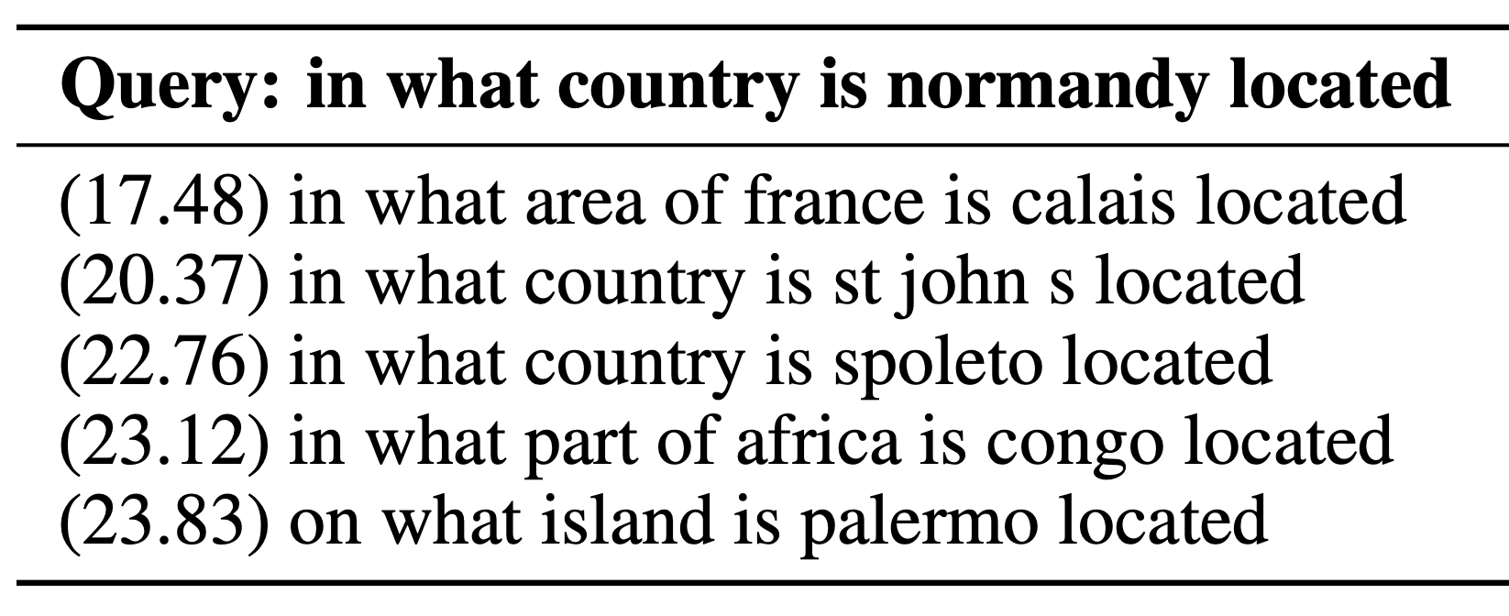
Inference (Prediction)
Local adaptation similar to MbPA (Sprechmann et al., 2018).
Notes:
Here, given a new test example x, we first encode the question part of the new question and retrieve similar examples from our memory using k nearest neighbors. For example,
Given a query in what country is normandy located, the neighbors are shown in this table. We can see that they are relevant examples in the memory that seek similar information (location).

Slide 147
Inference (Prediction)
Local adaptation similar to MbPA (Sprechmann et al., 2018).
Notes:
After we retrieve similar examples from the memory, we perform local adaptation. The equality looks a bit complicated, but intuitively, what we do is we update parameters of our model such that they predict answers of examples we retrieve from the memory with high probability. We do this by standard gradient descent updates. After that, given this newly updated model, we make our prediction y hat. Note that this local adaptation is specific for each test example, since it depends on nearest neighbors. After making a prediction for this test example, the model is resetted to the original parameters.

Slide 148
Problem Setup
Task A eval
Task A eval
Task B eval
Task A eval
Task B eval
Task C eval
Task A - train
Task B - train
Task C - train
Standard setup, models know which task an example belongs to.
Never-Ending Language Learning, Mitchell et al., 2015

Slide 149
Problem Setup
Task A eval
Task A eval
Task B eval
Task A eval
Task B eval
Task C eval
Task A - train
Task B - train
Task C - train
Our more difficult and realistic setup.
Notes:
Our lifelong learning setup is more difficult since we do not provide information about which dataset an example comes from to the model. So from the perspective of the model, every training and test examples look similar, and the model needs to guess which skills are relevant to solve it In this work, for simplicity, we consider Task A, B, and C to be different datasets from with the same formulation (e.g., question answering, text classification). Throughout the talk,, I will use question answering as an example (eventually every task can be formulated as question answering, but I will talk about that later).
== remove this slide
Show QA example here

Slide 150
This Talk
Episodic memory in lifelong language learning.
de Masson d’Autume et al., NeurIPS 2019
A framework for self-supervised language representation learning methods.
Kong et al., ICLR 2020
Meta, transfer, continual learning
Memory models
Representation learning
Notes:
I will now move on to our second project, which is at the intersection of representation learning and transfer learning.

Slide 151
Research Areas
A universal language model that continually learns to perform multiple tasks in many languages.
Semi-parametric models/memory-augmented neural networks.
Architectural advances and structural biases for self-supervised representation learning.
Generative language models.
Yogatama and Mann; AISTATS 2014; Yogatama et al., ICLR 2018; de Masson d’Autume; NeurIPS 2019
Yogatama and Smith; ACL 2014; ICML 2015; Yogatama et al., ICLR 2017; Maillard et al., JNLE 2019
Yogatama et al., TACL 2014; Yogatama et al., arXiv 2017; Kong et al., ICLR 2018.
Reasoning (Dhingra et al., 2020), interactions with other modalities (Baltrusaitis et al., 2019), robustness (Huang et al., EMNLP 2019), fairness (Manzini et al., 2019), and others
Notes:
Also, I would like to note that there are other important abilities in general linguistic intelligence that I will not discuss in this talk, including commonsense reasoning, interactions with other modalities, and robustness to adversaries. (be a bit more clear about whether you're interested in these, maybe offer some citations of key works that you respect in these veins. signal that you're engaged in related areas, and maybe that you're excited about collaborating on them.

Slide 152
Future Directions
Meta, transfer, continual learning
Generative models
Memory models
Representation learning

Slide 153
Frontiers of NLP
Meta, transfer, continual learning
Memory models
Generative models
Representation learning

